Slide 1

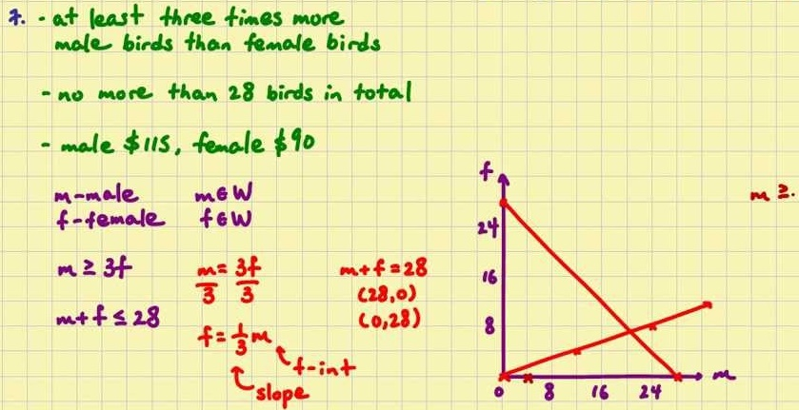
Mathematics (9-1) - iGCSE
2018-20
Year 07
Units 5 - 8 – Equations, Angles, Averages & Ranges, Perimeters and Volume

Slide 2
Contents
Page iv
5 Equations, inequalities and
sequences 34
5.1 Solving equations 1 34
5.2 Solving equations 2 35
5.3 Solving equations with brackets 36
5.4 Introducing inequalities 36
5.5 More inequalities 37
5.6 Using formulae 38
5.7 Generating sequences 39
5.8 Using the nth term of a sequence 40
5 Problem-solving 41
6 Angles 43
6.1 Properties of shapes 43
6.2 Angles in parallel lines 44
6.3 Angles in triangles 45
6.4 Exterior and interior angles 46
6.5 More exterior and interior angles 48
6.6 Geometrical problems 49
6 Problem-solving 50
7 Averages and range 52
7.1 Mean and range 52
7.2 Mode, median and range 53
7.3 Types of average 54
7.4 Estimating the mean 56
7.5 Sampling 56
Problem-solving 57
8 Perimeter, area and volume 1 59
8.1 Rectangles, parallelograms and
Triangles 59
8.2 Trapezia and changing units 60
8.3 Area of compound shapes 61
8.4 Surface area of 3D solids 62
8.5 Volume of prisms 64
8.6 More volume and surface area 64
8. Problem-solving 66

Slide 3
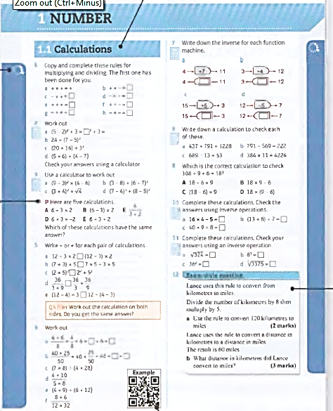
Contents
Page v
Icons alongside the questions show their level of difficulty. Questions in this book will range from 2
to 8
There is a section relating to every mastery lesson in the Student Book
This Practice Book is packed with extra practice on all the content of the Student Book - giving you more opportunities to practise answering simple questions as well as problem-solving and reasoning ones.
The letters P and R are used to show where a question requires you to problem- solve or reason mathematically- essential skills for your GCSE.
Exam-style questions are included throughout to help you prepare for your GCSE exam.
QR codes link to worked examples from the Student Book which will help you with the question they are alongside.

Slide 4
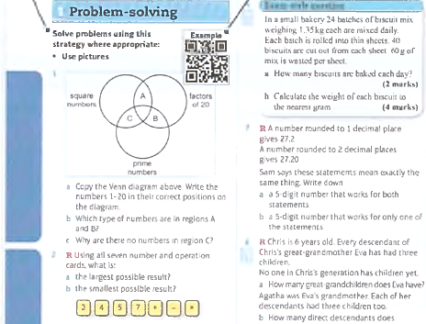
Contents
Page vi
These are strategies that you have learned so far in the Student Book. They build up as you work through the book. Consider whether they could help you to answer some of the following questions.
A QR code is given in the problem solving section where you learn a new strategy in that unit in the Student Book. Scan it to see the worked example and remind yourself of the strategy.
The R symbol indicates questions where you are required to reason mathematically. Questions in this section do not have the P symbol as they are all problem-solving.

Slide 5

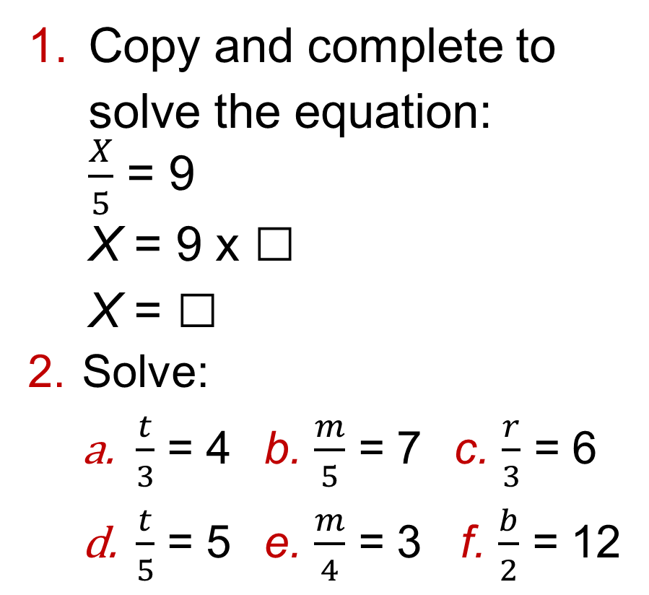
5.1 – Solving Equations 1
Page 34
Copy and complete to solve the equation:
$\frac{X}{5}$ = 9
X = 9 x □
X = □
Solve:
$\frac{t}{3}$ = 4 b. $\frac{m}{5}$ = 7 c. $\frac{r}{3}$ = 6
$\frac{t}{5}$ = 5 e. $\frac{m}{4}$ = 3 f. $\frac{b}{2}$ = 12

Slide 6

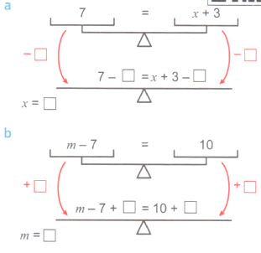
5.1 – Solving Equations 1
Page 34
Copy and complete to
solve these equations
using a balancing method.

Slide 7
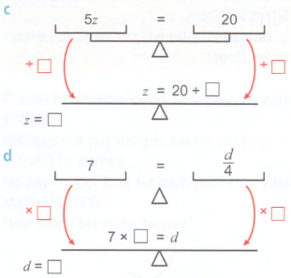
5.1 – Solving Equations 1
Page 34
Copy and complete to solve these equations using a balancing method.

Slide 8
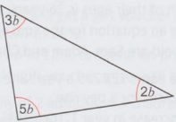
5.1 – Solving Equations 1
Page 34
Use a balancing method to solve:
m + 8 = 12 b. y – 5 = 14
x + 11 = 12 d. 5 + r = 20
Simplify the left-hand side, then solve:
4x + 6x = 30 b. 9y – 4y = 15
8m – 7m = 12 d. 3q + q = 24
R a Write an equation for the sum of these angles:
b. Solve your equation to find the value of b.

Slide 9
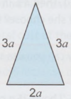

5.1 – Solving Equations 1
Page 34
R a The perimeter
of this isosceles
triangle is 30 cm.
Write an equation for
the perimeter.
Work out the value of a.
Work out the length of
the shortest side.
R Calculate the size of the smallest angle.
Q8 hint – What do the angles in a quadrilateral add up to.

Slide 10
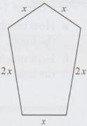
5.1 – Solving Equations 1
Page 34
9 – Exam-Style Questions
The perimeter of this pentagon is 56 cm. Work out the length
of the sides
marked x
and 2x.
(4 marks)

Slide 11
5.1 – Solving Equations 1
Page 35
Amy works x hours and earns £12 per hour. One day she is paid £84.
Write an equation involving x.
Solve your equation to work out how many hours Amy worked.
Yogini eats 12 chocolates from a box containing y chocolates.
There are now 18 chocolates in the box.
Write an equation involving y.
Solve your equation to find the original number of chocolates in the box.

Slide 12


5.2 – Solving Equations 2
Page 35
Copy and complete these inverse function machines.

Slide 13

5.2 – Solving Equations 2
Page 35
a Solve the equation
3x - 4 = 17 using this function machine.
Solve these equations using function machines.
4x + 5 = 13
2m - 7 = 11
8m + 10 = 30

Slide 14
5.2 – Solving Equations 2
Page 35
Copy and complete:
4b - 6 = 22
4b - 6 + □ = 22 + □
4b = □
b = □
9m + 3 = 21
9m + 3 - □ = 21 - □
9m = □
m = □

Slide 15
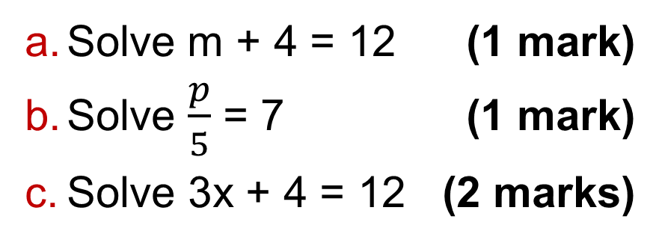
5.2 – Solving Equations 2
Page 35
Solve these equations.
3x + 4 = 10 b 5x - 7 = 8
2x – 6 = 14 d 6x + 4 = 10
2x + 2 = 3 f 7x + 3 =9
2a + 3 = -3 h -2x + 4 = -2
a + 7 = -1
5 – Exam-Style Questions
Solve m + 4 = 12 (1 mark)
Solve $\frac{p}{5}$ = 7 (1 mark)
Solve 3x + 4 = 12 (2 marks)

Slide 16
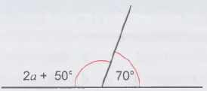
5.2 – Solving Equations 2
Page 35
R I think of a number. I divide it by 3 and add 7. The result is 12.
Find the number.
R a Write an equation for the diagram.
Solve your equation to find the value of a.

Slide 17
5.2 – Solving Equations 2
Page 35
R The sizes of the angles in a triangle are:
2a⁰, 6a – 30⁰ and 10⁰ + 2a⁰
Find the value of a.
R The length of each side of a regular pentagon is (a + 5) cm. The perimeter of the pentagon is 40cm. What is the value of a?

Slide 18

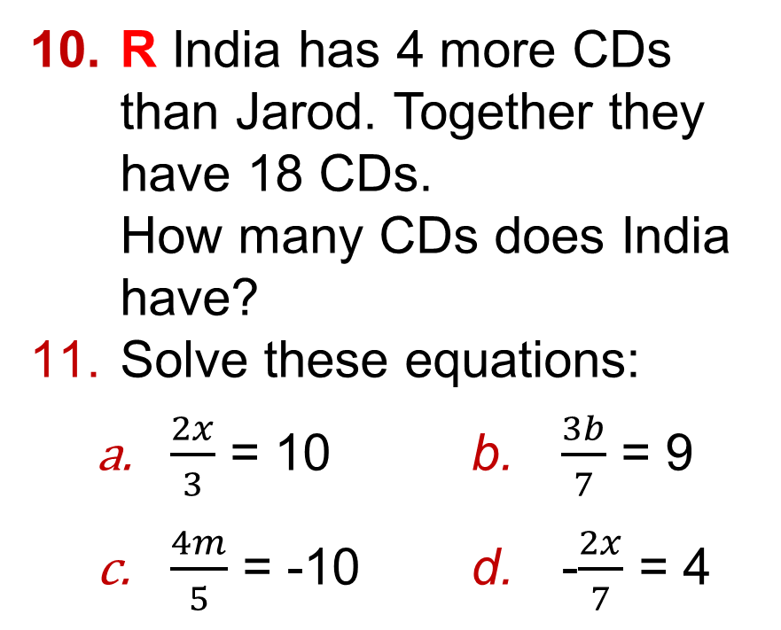
5.2 – Solving Equations 2
Page 35
R India has 4 more CDs than Jarod. Together they have 18 CDs.
How many CDs does India have?
Solve these equations:
$\frac{2x}{3}$ = 10 b. $\frac{3b}{7}$ = 9
$\frac{4m}{5}$ = -10 d. -$\frac{2x}{7}$ = 4
Q11a hint -

Slide 19
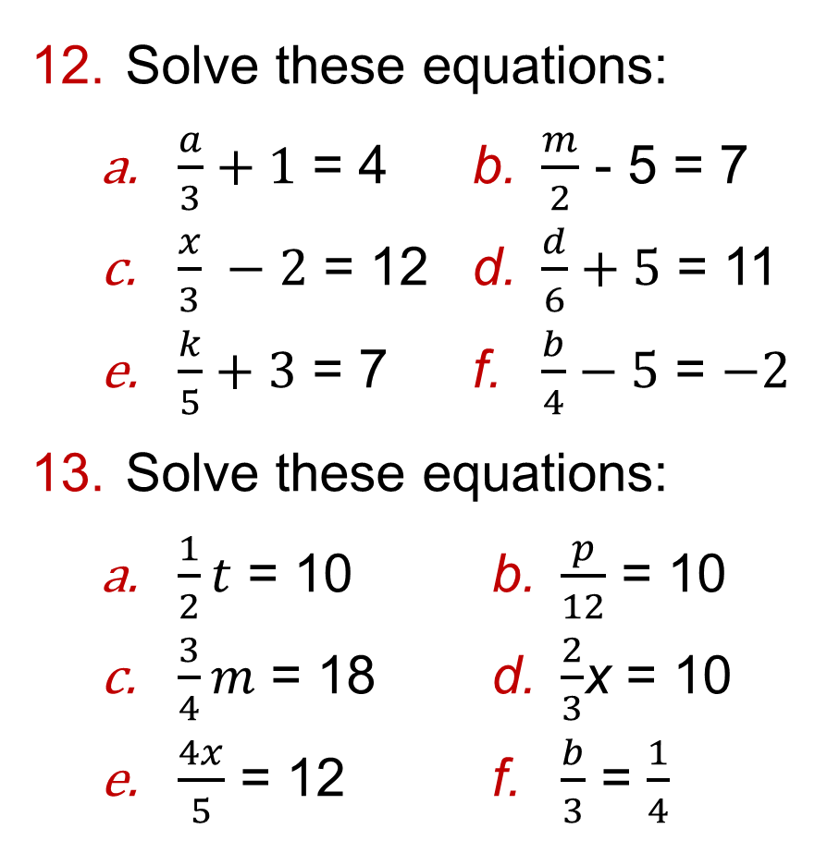
5.2 – Solving Equations 2
Page 35
Solve these equations:
$\frac{a}{3}+1$ = 4 b. $\frac{m}{2}$ - 5 = 7
$\frac{x}{3} −2$ = 12 d. $\frac{d}{6}+5$ = 11
$\frac{k}{5}+3$ = 7 f. $\frac{b}{4}−5$ = $−2$
Solve these equations:
$\frac{1}{2}t$ = 10 b. $\frac{p}{12}$ = 10
$\frac{3}{4}m$ = 18 d. $\frac{2}{3}$x = 10
$\frac{4x}{5}$ = 12 f. $\frac{b}{3}$ = $\frac{1}{4}$

Slide 20
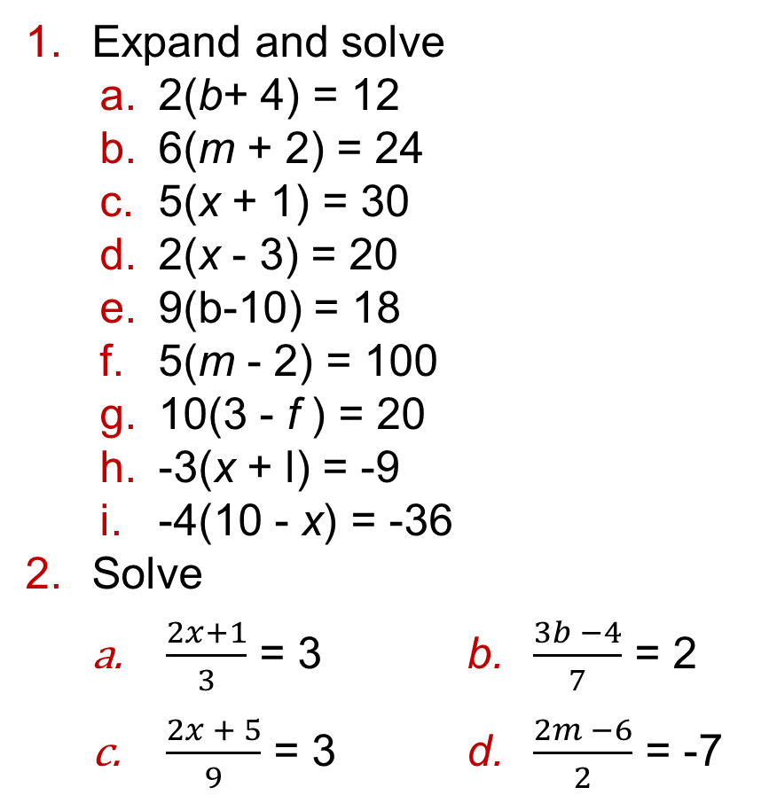
5.3 – Solving Equations with Brackets
Page 36
Expand and solve
2(b+ 4) = 12
6(m + 2) = 24
5(x + 1) = 30
2(x - 3) = 20
9(b-10) = 18
5(m - 2) = 100
10(3 - f ) = 20
-3(x + l) = -9
-4(10 - x) = -36
Solve
$\frac{2x+1}{3}$ = 3 b. $\frac{3b −4}{7}$ = 2
$\frac{2x + 5}{9}$ = 3 d. $\frac{2m −6}{2}$ = -7

Slide 21
5.3 – Solving Equations with Brackets
Page 36
Solve these equations. Example
10x = 8x + 12
5x = 2x + 36
2c + 7 = 3c + 2
4b - 30 = b + 3
Solve these equations.
3a + 10 = 7a – 2
2a + 5 = a + 3
2b + 7 = 5b - 23
3m - 10 = m + 1
5x - 2 = 2x - 4 f 3b + 5 = 5b - 2
Solve these equations.
20 - 3x = 2 b 10 - 2x = 5x + 3
3 - 2x = 9 + x d 10 + 2x = 20- 3x
5x - 4 = 10 - 2x f 8x + 1 = 5 - x

Slide 22
5.3 – Solving Equations with Brackets
Page 36
6 – Exam-Style Questions
Solve:
4(x - 1) = 2x + 14 (4 marks)
R Lawrence is paid 5 times as much as Ethan.
He also earns £40 more than Ethan.
How much do they each earn?
Q7 hint - Write an equation and solve it. Use x for Ethan's earnings.

Slide 23
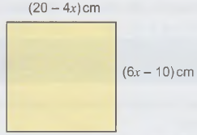
5.3 – Solving Equations with Brackets
Page 36
Expand the brackets on both sides, then solve,
3(b+ 7) = 12(b + 1)
2(m - 3) = 4(6 - m)
4(3 + m) = 6(m - 2)
4(x + 1) = 3(3 + x)
10(10 + x) = 12(2x + 6)
5(2m + 7) = 5(5m - 2)
a Work out the lengths of the sides
of the square.
b What is
the
perimeter?

Slide 24
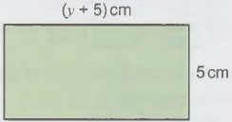
5.3 – Solving Equations with Brackets
Page 36
P A rectangle has width 5 cm, and the length is y cm more.
The area of the rectangle is 40 cm².
Write an equation and solve it to find y.
What is the perimeter of the rectangle?

Slide 25

5.4 – Introducing Inequalities
Page 36
Draw six number lines from -5 Example to +5. Show these inequalities.
x < 4 b x > -2
x < -0-5 d x > -3
x ≤ 3½ f x ≥ -4
Draw six number lines from -5 to +5. Show these inequalities.
-2 < x < 3 b -3 < x ≤ 0
1 ≤ x ≤ 4 d -4 < x ≤ -1
-½ < x ≤ 5 f -3 ≤ x < -2

Slide 26
5.4 – Introducing Inequalities
Page 37
Write down the inequalities represented on these number lines.
X
-5 -4 -3 -2 -1 0 1 2 3 4 5
X
-5 -4 -3 -2 -1 0 1 2 3 4 5
X
-5 -4 -3 -2 -1 0 1 2 3 4 5

Slide 27
5.4 – Introducing Inequalities
Page 37
Write down the inequalities represented on these number lines.
X
-5 -4 -3 -2 -1 0 1 2 3 4 5
X
-5 -4 -3 -2 -1 0 1 2 3 4 5
X
-5 -4 -3 -2 -1 0 1 2 3 4 5

Slide 28
5.4 – Introducing Inequalities
Page 37
When exercising, Mr. Williams's heart rate, h, is between 185 and 190 bpm (beats per minute) inclusive.
Show this on a number line.
Write down the integer values of x that satisfy each of these inequalities.
3 < x < 10 b -2 < x ≤ -1
-2 ≤ x ≤ 2 d 1.5 < x < 6
-2½ < x ≤ 4 f -1 < x < 1

Slide 29
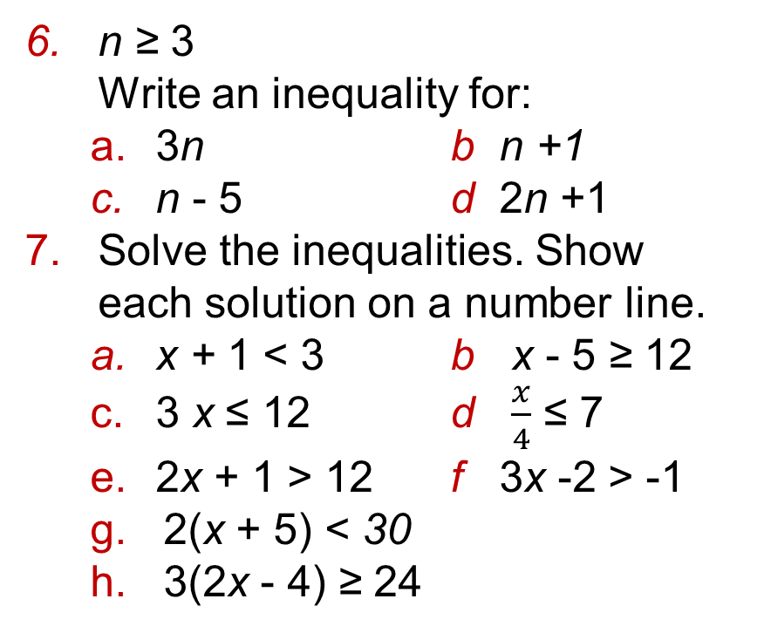
5.4 – Introducing Inequalities
Page 37
n ≥ 3
Write an inequality for:
3n b n +1
n - 5 d 2n +1
Solve the inequalities. Show each solution on a number line.
x + 1 < 3 b x - 5 ≥ 12
3 x ≤ 12 d $\frac{x}{4}$ ≤ 7
2x + 1 > 12 f 3x -2 > -1
2(x + 5) < 30
3(2x - 4) ≥ 24
Q7 hint - Use the balancing method - do the same to both sides.

Slide 30
5.4 – Introducing Inequalities
Page 37
8 – Exam-Style Questions
x is an integer.
-2 ≤ x < 2
List the possible values of x.
(2 marks)
Write down the inequality shown in the diagram.
(2 marks)
Solve 2x + 4 > 19 (2 marks)
X
-5 -4 -3 -2 -1 0 1 2 3 4 5

Slide 31
5.4 – Introducing Inequalities
Page 37
Solve
2x +5 > 4x - 7
3x -10 ≤ 5x +2
10 – 3x ≥ 4x - 4
10 - x > x - 10
5 - 3x < 10 - 2x
2x + 1 ≥ 1 – 2x
10 – Exam-Style Questions
The sum of a number and 1 more than double the number is more than 5.
What is the smallest positive integer that the number could be? (4 marks)

Slide 32


5.4 – Introducing Inequalities
Page 37
R / P Tyrone rounds a 3-digit whole number to the nearest 100. He gets 600.
Write an inequality to show what the number could have been.
P I think of a number, double it and add 4.
My answer is greater than when I multiply the number by 3 and subtract 5.
Find three possible values for my number.

Slide 33

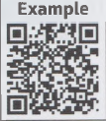
5.5 – More Inequalities
Page 37
Solve:
4 < 2x ≤ 16 b -3 < 3x ≤ 1
0 ≤ 4x < 20
-2 ≤ 3x ≤ 15
-7 ≤ 4x < 15
-4 < 5x ≤ 18
Solve
11 < 4x - 1 < 23
5 < 2x + 3 ≤ 21
3 ≤ 5x – 2 ≤ 13
-4 < 3x + 8 < 11
-9 < 2x + 1 ≤ -1
-12 ≤ 4x + 4 < 0

Slide 34
5.5 – More Inequalities
Page 38
Solve each two-sided inequality and show each solution set on a number line.
10 < 5x < 25
14 ≤ 4x – 2 < 30
-2 ≤ 3x ≤ 2
4 < 2x + 1 ≤ 10
12 ≤ 3(2x + 5) < 21
-6 ≤ 3(2x + 3) ≤ 9
On a number line you can see that
-4 < -3.
Multiply both sides of the inequality by -1. Is the inequality still true?
5 < -x. Write an inequality for x.
-4 -3 -2 -1 0 1 2

Slide 35
5.5 – More Inequalities
Page 38
Solve these double inequalities and show each solution set on a number line.
-6 < -2(x + 3) < 10
4 < -3x - 2 ≤ 7
-2 < 2(5 -2x) ≤ 10
Solve the inequality 10 - 5x ≥ 5 - 2x What is the smallest integer that satisfies it?
P The sum of three consecutive whole numbers is less than 33.
What are the largest whole numbers that they could be?

Slide 36
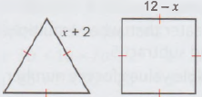

5.5 – More Inequalities
Page 38
P The perimeter of the equilateral triangle is more than the perimeter of the square.
Work out the range of values for the side length of the square.
For each pair find the integer values of x which satisfy both inequalities,
x > 3 and x < 7
x > -2 and x 4
X ≥ -10 and x ≤ -2
x > -3 and x ≥ 1

Slide 37
5.5 – More Inequalities
Page 38
10 – Exam-Style Questions
Find the integer value of x which satisfies both the inequalities
x - 4 > 2 and 3x + 6 < 30
(2 marks)
Q10 hint - Solve each inequality and then show your solutions on a number line to get the final answer.

Slide 38
5.6 – Using Formulae
Page 38
d = st
Find the value of t when
i d = 20, s = 5 ii d = 35, s = 7
Find the value of s when
i d = 12, t = 2 ii d = 121, t=11
y = 2x + 5
Work out the value of x when
y = n b y = -1
y = 105 d y = -15
Q1a hint d = s x t
20 = 5 x t
□= t

Slide 39
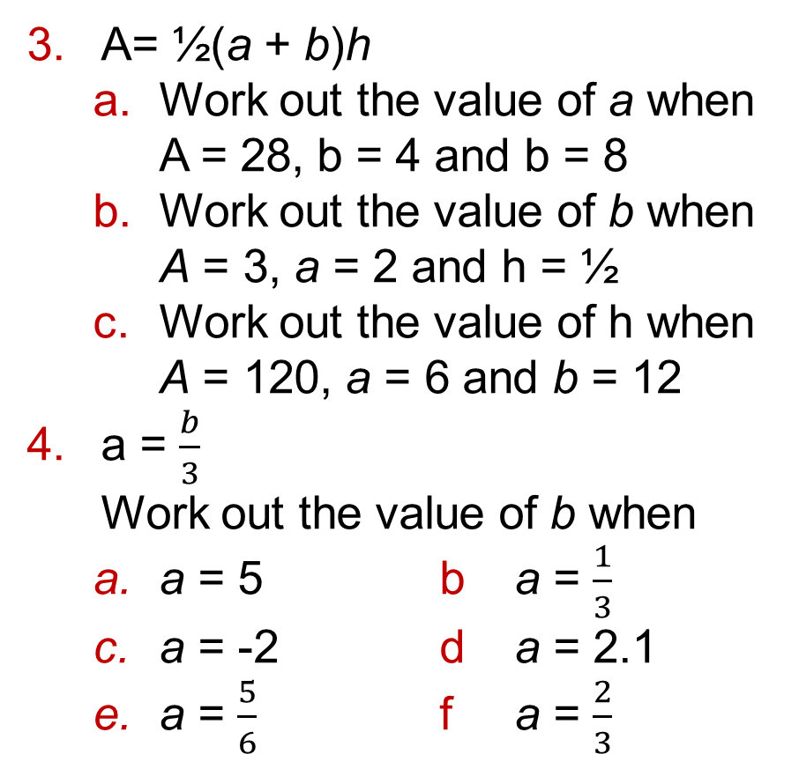
5.6 – Using Formulae
Page 38
A= ½(a + b)h
Work out the value of a when
A = 28, b = 4 and b = 8
Work out the value of b when
A = 3, a = 2 and h = ½
Work out the value of h when
A = 120, a = 6 and b = 12
a = $\frac{b}{3}$
Work out the value of b when
a = 5 b a = $\frac{1}{3}$
a = -2 d a = 2.1
a = $\frac{5}{6}$ f a = $\frac{2}{3}$

Slide 40
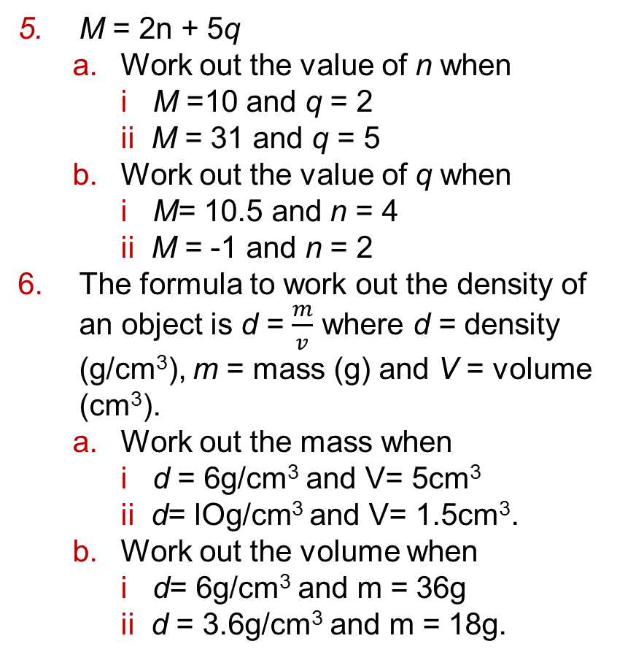
5.6 – Using Formulae
Page 38
M = 2n + 5q
Work out the value of n when
i M =10 and q = 2
ii M = 31 and q = 5
Work out the value of q when
i M= 10.5 and n = 4
ii M = -1 and n = 2
The formula to work out the density of an object is d = $\frac{m}{v}$ where d = density (g/cm³), m = mass (g) and V = volume (cm³).
Work out the mass when
i d = 6g/cm³ and V= 5cm³
ii d= lOg/cm³ and V= 1.5cm³.
Work out the volume when
i d= 6g/cm³ and m = 36g
ii d = 3.6g/cm³ and m = 18g.

Slide 41
5.6 – Using Formulae
Page 39
7 – Exam-Style Questions
A = 3b + c b = 12.5 c = 6.2
Work out the value of A.
(2 marks)
A = 3b + c, A = 15.3 c = -3.6
Work out the value of b.
(2 marks)
In the formula A = 12r², A is the approximate surface area of a sphere (cm²) and r is the radius (cm).
Use A = 12r² to work out r when A = 108cm².

Slide 42
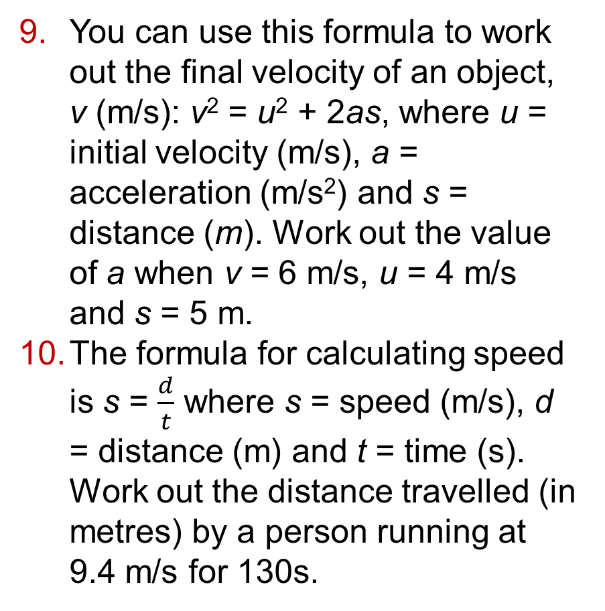
5.6 – Using Formulae
Page 39
You can use this formula to work out the final velocity of an object,
v (m/s): v² = u² + 2as, where u = initial velocity (m/s), a = acceleration (m/s²) and s = distance (m). Work out the value of a when v = 6 m/s, u = 4 m/s and s = 5 m.
The formula for calculating speed is s = $\frac{d}{t}$ where s = speed (m/s), d = distance (m) and t = time (s).
Work out the distance travelled (in metres) by a person running at 9.4 m/s for 130s.

Slide 43
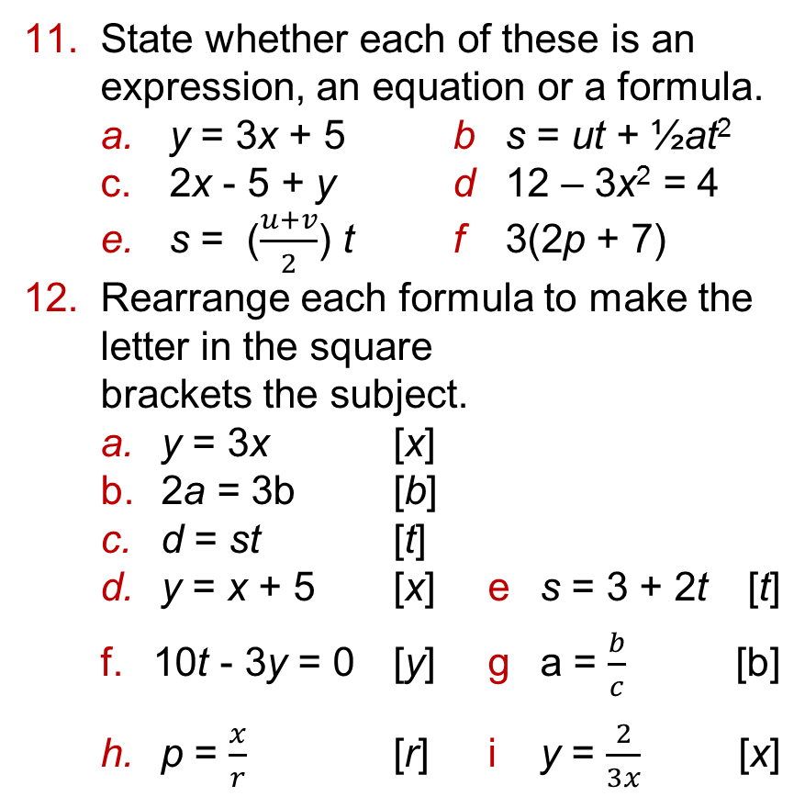
5.6 – Using Formulae
Page 39
State whether each of these is an expression, an equation or a formula.
y = 3x + 5 b s = ut + ½at²
2x - 5 + y d 12 – 3x² = 4
s = ($\frac{u+v}{2}$) t f 3(2p + 7)
Rearrange each formula to make the letter in the square
brackets the subject.
y = 3x [x]
2a = 3b [b]
d = st [t]
y = x + 5 [x] e s = 3 + 2t [t]
10t - 3y = 0 [y] g a = $\frac{b}{c}$ [b]
p = $\frac{x}{r}$ [r] i y = $\frac{2}{3x}$ [x]

Slide 44
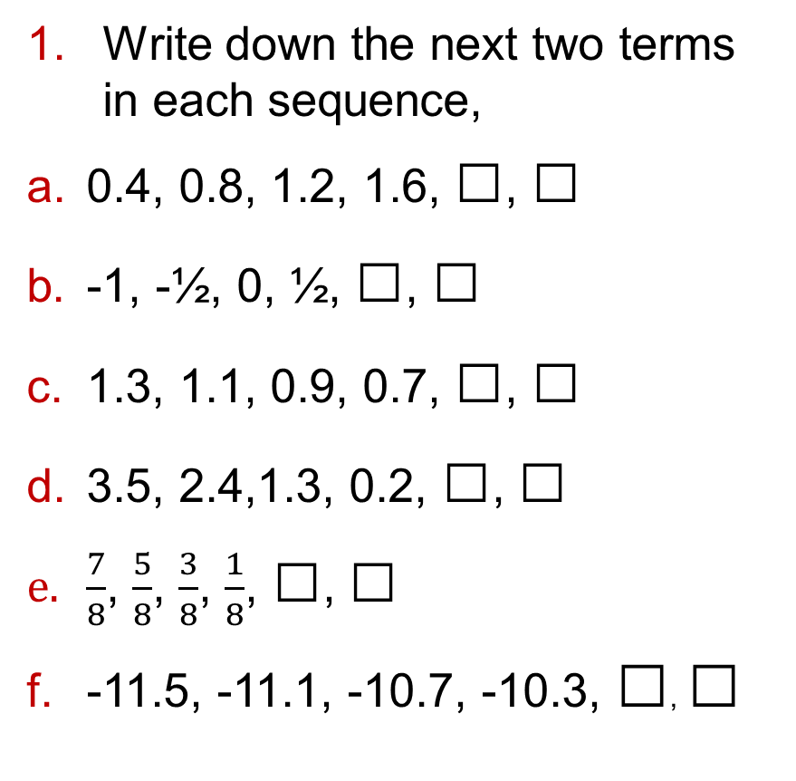
5.7 – Generating Sequences
Page 39
Write down the next two terms in each sequence,
0.4, 0.8, 1.2, 1.6, □, □
-1, -½, 0, ½, □, □
1.3, 1.1, 0.9, 0.7, □, □
3.5, 2.4,1.3, 0.2, □, □
$\frac{7}{8}$, $\frac{5}{8}$, $\frac{3}{8}$, $\frac{1}{8}$, □, □
-11.5, -11.1, -10.7, -10.3, □, □

Slide 45

5.7 – Generating Sequences
Page 39
Use the first term and the term-to-term rule to generate the first five terms of each sequence.
start at 5 and add 0.7
start at 4 and subtract 0.6
start at 9 and subtract 4
start at -2 and add 7
start at -8 and add 3
start at -3 and subtract 4
In a Fibonacci sequence, the term-to-term rule is 'add the two previous terms to get the next one.' Write the next three terms in each Fibonacci sequence,
1, 2, 3, 5, 8, ...
2, 5, 7,12, 19, ...
4, 4, 8, 12, 20, ...

Slide 46
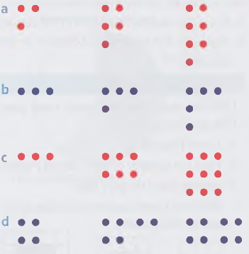
5.7 – Generating Sequences
Page 39
Each sequence is made up of a pattern of dots. For each sequence
Draw the next two patterns.
Draw a table like this:
Write down the rule to continue the pattern and complete it for each pattern.
Work out the number of dots needed for the 10th pattern.

Slide 47
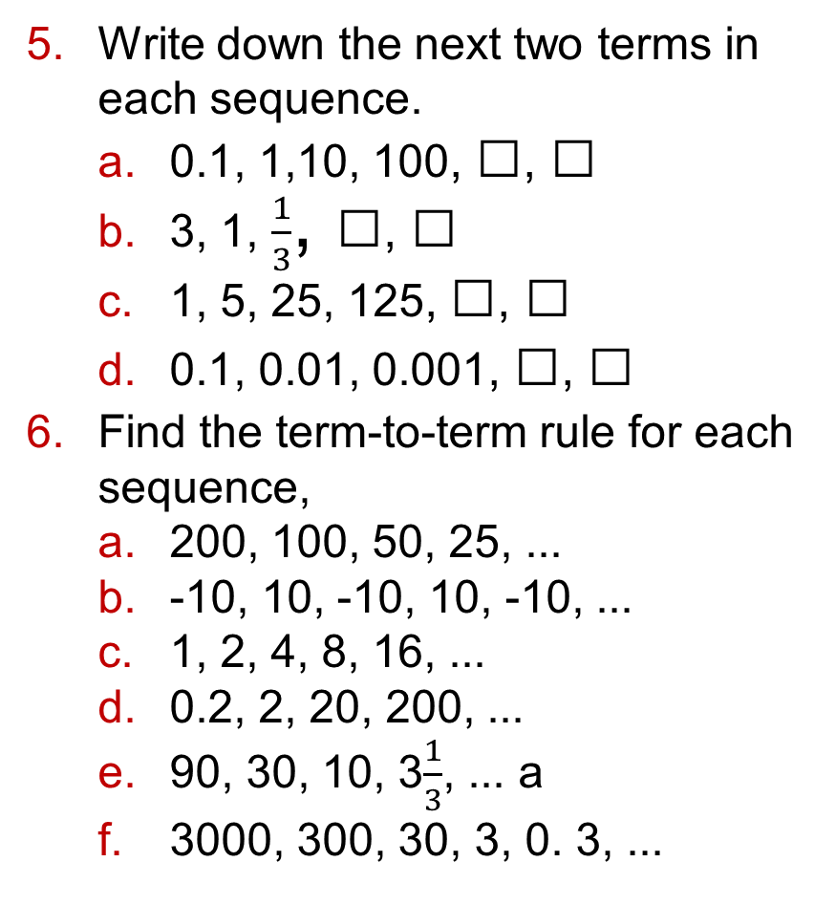
5.7 – Generating Sequences
Page 39
Write down the next two terms in each sequence.
0.1, 1,10, 100, □, □
3, 1, $\frac{1}{3}$, □, □
1, 5, 25, 125, □, □
0.1, 0.01, 0.001, □, □
Find the term-to-term rule for each sequence,
200, 100, 50, 25, ...
-10, 10, -10, 10, -10, ...
1, 2, 4, 8, 16, ...
0.2, 2, 20, 200, ...
90, 30, 10, 3$\frac{1}{3}$, ... a
3000, 300, 30, 3, 0. 3, ...

Slide 48

5.7 – Generating Sequences
Page 40
This sequence made from counters shows the first three square numbers.
Draw the next two patterns in the sequence,
Write down the number of counters in each pattern.
Work out the differences between the numbers of counters,
Follow the sequence to work out the number of counters in the 10th pattern.
Q7c and d hint -

Slide 49

5.7 – Generating Sequences
Page 40
This sequence made from counters shows the first three pentagonal numbers.
Draw the next two patterns in the sequence,
Work out the number of counters in the 7th pattern.

Slide 50
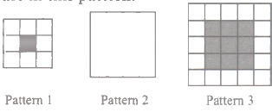
5.7 – Generating Sequences
Page 40
9 – Exam-Style Questions
Here are some patterns made from grey tiles and white tiles.
Draw Pattern 4.
Find the number of grey tiles in Pattern 6. A pattern has 100 grey tiles,
Work out how many white tiles there are in this pattern.
(4 marks)

Slide 51
5.8 – Using the nth Term of a Sequence
Page 40
A sequence has nth term 3n - 1. Copy and complete this table to work out the first five terms of the sequence.
Write the first five terms of the sequence with nth term
2n b n + 5 c 2n - 5
10 - n e ½n + 1 f 20 - 4n
-n + 1 h -2n + 7
n | 1 | 2 | 3 | 4 | 5
Term | 3 x 1 – 1 = □ | 3 x 2 – 1 = □

Slide 52

5.8 – Using the nth Term of a Sequence
Page 40
Find the nth term for each sequence.
3, 7, 11, 15, 19, ... b 12, 22, 32, 42, ...
5, 6, 7, 8, 9, ... d 10, 8, 6, 4, 2, ...
22, 19, 16, 13, 10 ...
13, 11, 9, 7, 5, ...
For each sequence, explain whether each number in the brackets is a term in the sequence or not.
4, 7, 10, 13, ... (34,61)
3, 8, 13, 18, 23, ... (43,55)
10, 18, 26, 34, 42, ... (71,84)
-3, 4, 11, 18,25, ... (70,100)
40, 32, 24, 16, 8, ... (-16,-40)
20, 17, 14, 11, 8, ... (-2,-10)
Q4a hint - Work
out the nth term

Slide 53
5.8 – Using the nth Term of a Sequence
Page 40
Using the nth term given, find the 20th term,
a 5n b 2n - 7 c 12 - 4n
Find the nth term for each sequence.
Use it to work out the 10th term,
Find the nth term for each sequence.
0, 2,4,6, 8, ... b 5,11,17,23, ...
12, 11,10,9, ... d 6, 2,-2,-6, ...
Find the first term over 100 for each sequence.
3,6,9,12, ... b 10,21,32,43, ...
8,12,16,20,... d 15,30,45,60,....

Slide 54
5.8 – Using the nth Term of a Sequence
Page 41
Here are the first four terms in a number sequence.
37, 33, 29, 25, ...
Write down the next term in this number sequence.
Work out the nth term for this number sequence.
Can 2 be a term in this sequence?
Give a reason for your answer.
Write down the first five terms of the sequence with nth term
n² b n² + 3 c 4n²
½n² e 10 - n² f -n²

Slide 55

5.8 – Using the nth Term of a Sequence
Page 41
10 – Exam-Style Questions
Here is a pattern made from sticks.
Draw the next pattern in the sequence,
Copy and complete this table for the numbers of sticks used to make the patterns.
Write, in terms of n, the number of sticks needed for pattern n.
How many sticks are needed for pattern 20? (5 marks)
Term | 1 | 2 | 3 | 4 | 5
No of sticks

Slide 56
5.8 – Using the nth Term of a Sequence
Page 41
P Sarah makes a pattern sequence with squares.
□□□□ □□□□ □□□□
□□ □□
□□
Draw the next pattern in the sequence.
Sarah has 38 squares.
Does she have enough to make the
10th pattern
the 20th pattern?
Work out the pattern number of the biggest pattern she can make.

Slide 57
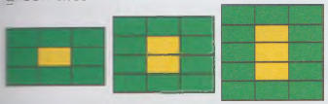
5.8 – Using the nth Term of a Sequence
Page 41
P Here is a pattern sequence of yellow and green tiles.
Copy and complete the table for the numbers of yellow tiles and the numbers of green tiles.
Write down the nth term for the sequence of the numbers of yellow tiles.
Pattern number | 1 | 2 | 3 | 4 | 5
No. of yellow tiles
No. of green tiles

Slide 58
5.8 – Using the nth Term of a Sequence
Page 41
P Here is a pattern sequence of yellow and
green tiles.
How many yellow tiles are there in the 20th pattern?
How many green tiles are there in the 30th pattern?
Fadeelah has 60 green tiles and 15 yellow tiles. Which is the largest complete pattern she can make?
Pattern number | 1 | 2 | 3 | 4 | 5
No. of yellow tiles
No. of green tiles

Slide 59
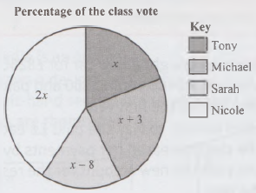
5 – Problem Solving
Page 41
Solve problems using these strategies where appropriate:
Use pictures
Use smaller numbers
Use bar models.
1 – Exam-Style Questions
The pie chart
right shows the
percentages the
four nominees
received in a
class vote. The
percentages are
x x + 3 x- 8 2x
What percentage of the vote did Sarah get? (4 marks)

Slide 60
5 – Problem Solving
Page 42
A rectangle has a height of p cm and a width of (p + 2) cm. The area of the rectangle is 24 cm².
Write an equation for the area, A, of the rectangle in terms of p.
p is a whole number.
Solve the equation to find p.

Slide 61
5 – Problem Solving
Page 42
R Weight is the force exerted on a mass. On Earth, an object's weight (in N) is 10m, where m is the mass (in kg).
To calculate the pressure, P (in N/m²), divide the force applied, F, by the area, A.
Write down the formula for calculating the pressure in terms of m and A.
An elephant's mass is 5000 kg. Each foot has an area of 0.1 m².
Work out the pressure for each foot.
The mass of a woman wearing stiletto heels is 63 kg. Each heel has an area of 0.00004 m².
Work out the pressure for each heel.
Which will do more damage to a lawn, the elephant or the woman?

Slide 62
5 – Problem Solving
Page 42
R Ken has £45. He gets £12 a week pocket money and will save half of it each week.
Write down how much he will have after the 1st, 2nd, 3rd and 4th weeks.
This forms a sequence. How can you tell?
What is the nth term of this sequence?
How much will he have after 6 months?
Q4 hint - Draw bar models to show the amount each week.

Slide 63
5 – Problem Solving
Page 42
R Hanna bought a new car for £8250.
She paid a deposit of £2150 and paid the rest back during the first year.
From January to May she paid £x each month. She then increased her payments by £100 and paid the new amount for the rest of the year.
Show that 12x + 2850 = 8250
How much did Hanna pay back in November?

Slide 64
5 – Problem Solving
Page 42
Annie's mum is 165 cm tall. Annie is still not as tall as her mum when she stands on a 20 cm step.
Use h to represent Annie's height,
Write an inequality for Annie's height.
Annie is more than twice the height of her baby brother. He is 65 cm tall.
Write another inequality for Annie's height,
Draw on a number line the range of possible values for Annie's height.

Slide 65
5 – Problem Solving
Page 42
Three tanks, A, B and C, each have x litres of a solution in them.
Water is added to each tank to dilute the solution. Tank A now has 460000 litres more, B has double the original amount and C has 4 times the original amount plus 100 000 litres.
Tank A has more solution in it than tank B but less than tank C.
Work out the possible range of values for x.
Write your answer as a double inequality,
Write three possible values for x that are multiples of 100000.

Slide 66
5 – Problem Solving
Page 42
R A new school is opening with only Year 7 at first. It estimates that the total population of the students and staff will grow like a sequence with an nth term of 125n + 5 for 7 years. The population will then stay constant,
What is the total population of the school in each of the first 4 years expected to be?
Will there be a time when the school has a population of 725 when full?
Explain your answer.
What will be the total population of the school 10 years after opening?

Slide 67
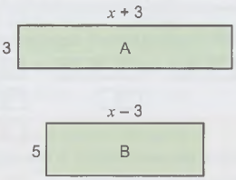
5 – Problem Solving
Page 42
P Shapes A and B are rectangles. Shape A has a larger area than shape B.
Work out a range of values for the perimeter of shape A.

Slide 68
5 – Problem Solving
Page 42
R A tank is 1 m deep. David fills the tank with water. The water is 12.4 cm high when he starts. The water level in the tank rises by 5.6 cm every minute.
What is the water level after 3 minutes?
What is the water level after n minutes?
The tank must not be completely filled. Write an inequality for the water level in terms of n.
Solve your inequality. What does it tell you?

Slide 69
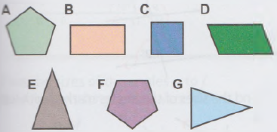
6.1 – Angles – Properties of Shapes
Page 43
Write down the letters of two pairs of shapes that are congruent.
Q1 hint - Congruent shapes are exactly the same size and shape, so if you cut them out, one shape fits on top of the other exactly.
It does not matter if you turn them over or turn them round.

Slide 70
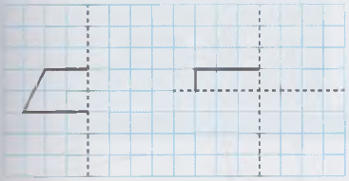
6.1 – Angles – Properties of Shapes
Page 43
These parts of shapes are drawn on a centimetre square grid. The dotted lines are lines of symmetry.
Copy and complete the diagrams.
Name each shape and measure and label all its angles.

Slide 71
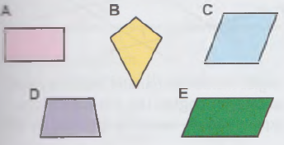
6.1 – Angles – Properties of Shapes
Page 43
Which of these shapes have
equal length diagonals
two pairs of equal sides
only one pair of parallel sides?

Slide 72
6.1 – Angles – Properties of Shapes
Page 43
R Name each quadrilateral being described,
I have two pairs of parallel sides and my opposite angles are equal.
I have four equal sides and my diagonals are not the same length.
I have two pairs of equal sides and one pair of equal angles.
My diagonals are the same length and bisect at 90°.

Slide 73
6.1 – Angles – Properties of Shapes
Page 43
P Draw a coordinate grid with axes labelled from -5 to 5.
Plot these points.
A(-1, 0), B(1, -1), C(1, 5)
Write down the coordinates of point that would make
a kite
a parallelogram
an isosceles trapezium.

Slide 74
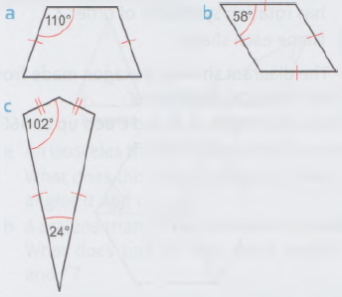
6.1 – Angles – Properties of Shapes
Page 43
Work out the sizes of the missing angles in each quadrilateral.

Slide 75
6.1 – Angles – Properties of Shapes
Page 43
R Charlie is an architect.
He draws a design for a path.
The left-hand section is a square and the others are rhombuses.
Charlie uses these rules in his design.
Angle c is 5% bigger than angle a, rounded to the nearest degree.
Angle e is 5% bigger than angle c, rounded to the nearest degree.
Angle g is 5% bigger than angle e, rounded to the nearest degree.
Work out the sizes of the angles a to h.

Slide 76
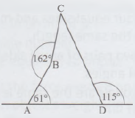
6.1 – Angles – Properties of Shapes
Page 44
8 – Exam-Style Questions
ABCD is a quadrilateral. Find the size of angle BCD.
Explain each stage of your working. (3 marks)

Slide 77
6.1 – Angles – Properties of Shapes
Page 44
P Draw a coordinate grid with axes labelled from -5 to 5.
Here are some coordinates for three shapes ABCD. Plot the points on your grid.
A(1, -2), B(-3, -2), C(-3,1)
A(0, -2), B(1, 2), C(0, 4)
A(-1, 1), B(2, -1), C(5, 1)
Join the points A to B and B to C in each shape,
Draw a point D for each shape so that it has rotation symmetry of order 2.
Name each shape.

Slide 78
6.1 – Angles – Properties of Shapes
Page 44
P The diagram shows a hexagon made from three identical rhombuses.
Show that angles a, b and c add up to 360°.
P The diagram shows a kite. Find the size of angle a.

Slide 79
6.2 – Angles in Parallel Lines
Page 44
The diagram shows a line crossing two parallel lines and angles labelled f, g, h and i. Write down two pairs of alternate angles.

Slide 80
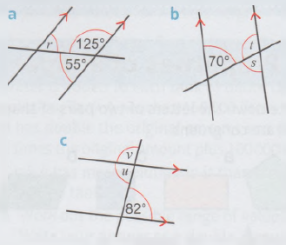
6.2 – Angles in Parallel Lines
Page 44
Find the sizes of the angles marked with letters.

Slide 81
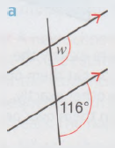
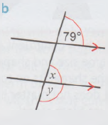
6.2 – Angles in Parallel Lines
Page 44
Find the sizes of the angles marked with letters.

Slide 82
6.2 – Angles in Parallel Lines
Page 44
Find the sizes of angles a to e.
Give reasons for your answers.
Choose your reasons from the box.
Angles on a straight line add up to 180°.
Angles □ and □ are alternate and equal.
Angles □ and □ are corresponding and equal.

Slide 83
6.2 – Angles in Parallel Lines
Page 44
Which angles in the diagram are equal? Give reasons for your answers.
Angles inside two parallel lines are called co-interior angles. Use this diagram to explain why co-interior angles add to 180°.

Slide 84
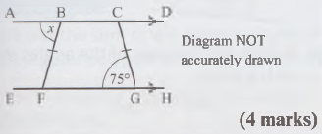
6.2 – Angles in Parallel Lines
Page 45
7 – Exam-Style Questions
ABCD and EFGH are straight lines. BCGF is an isosceles trapezium. Find the size of the angle marked x. Give reasons to explain your answer.

Slide 85
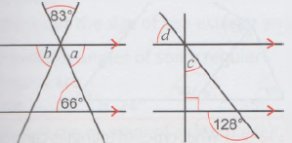
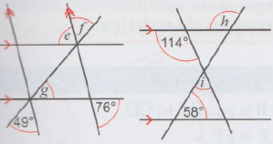
6.2 – Angles in Parallel Lines
Page 45
Find the sizes of the angles a to j.
Give reasons for your answers.

Slide 86
6.2 – Angles in Parallel Lines
Page 45
9 – Exam-Style Questions
AFB and CED are parallel lines.
EFG is a straight line.
Work out the size of the angle marked x. (3 marks)

Slide 87
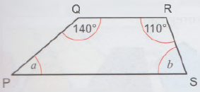
6.2 – Angles in Parallel Lines
Page 45
PQRS is a trapezium. Work out the sizes of the angles a and b.

Slide 88
6.3 – Angles in Triangles
Page 45
Calculate the sizes of the angles marked with letters.
Choose a reason from the box to explain each answer.
Reason 1 Angles about a point add up to 360°.
Reason 2 Angles on a straight line add up to 180°

Slide 89
6.3 – Angles in Triangles
Page 45
R The diagram shows an isosceles triangle and a scalene triangle.
An isosceles triangle has a line of symmetry. What does this tell you about the two angles a and c?
A scalene triangle has no lines of symmetry. What does this tell you about angles d, e and f?

Slide 90
6.3 – Angles in Triangles
Page 45
Find the sizes of the missing angles.

Slide 91

6.3 – Angles in Triangles
Page 45
In order to be usable, a ramp should make an angle of 20° or less with the horizontal,
How many degrees is this with the vertical?
Is either of these ramps usable? Explain your answer.
An engineer designs
this support for a
beam. What sizes
are angles a and b?

Slide 92
6.3 – Angles in Triangles
Page 46
R Sketch a copy
of this diagram.
Copy and
complete these
statements to
prove that the
sum of the angles in a triangle is 180°.
Statement Reason
a + b + c = □ Angles a, b and c lie on a straight line.
d= □ Angles d and □ are alternate.
e= □ Angles e and □ are alternate.
So d + b + e = a + b + c = □
This proves that the angles in a triangle sum to □.

Slide 93
6.3 – Angles in Triangles
Page 46
P Work out the sizes of the angles marked with letters.

Slide 94
6.3 – Angles in Triangles
Page 46
R Copy the diagram.
Copy and complete this proof to show that s = p + q.
p + q = 180° - □ because the angles in a triangle add up to □.
s = 180° - □ because r and s lie on a ______________ line.

Slide 95
6.3 – Angles in Triangles
Page 46
R Which statement is true about this triangle?
Angle z = angle y
Angle z = angle w + angle x
Angle z = angle x + angle y
Angle z = angle w + angle y

Slide 96
6.3 – Angles in Triangles
Page 46
R What sizes could angles a, b and c be? Choose possible angles from the cloud.
Angle z = angle y
Angle z = angle w + angle x
Angle z = angle x + angle y
Angle z = angle w + angle y

Slide 97

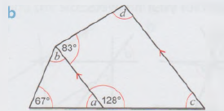
6.3 – Angles in Triangles
Page 46
P Work out the sizes of the angles marked with a letter.
Q11a hint - What types of triangles can you see?
Q11b hint What do the angles of a quadrilateral add up to? How can you use properties of parallel lines?

Slide 98
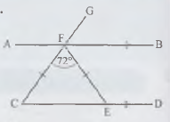
6.3 – Angles in Triangles
Page 46
12 – Exam-Style Questions
AB is parallel to CD.
CF = EF CFE = 72°
Calculate the size of AFG.
(3 marks)

Slide 99

6.4 – Interior and Exterior Angles
Page 46
Copy the polygons. Draw one interior angle and one exterior angle for each shape.
Write down whether each polygon is regular or irregular.

Slide 100
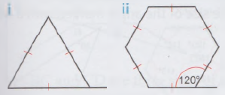
6.4 – Interior and Exterior Angles
Page 47
a Work out the size of one exterior angle of each regular polygon.
Work out the sum of the exterior angles of each regular polygon. What do you notice?
Q3 hint - In a regular polygon, all the exterior angles are equal.

Slide 101
6.4 – Interior and Exterior Angles
Page 47
A regular polygon has 12 sides.
How many equal exterior angles does it have?
Work out the size of one exterior angle.
The exterior angles of some regular polygons are
a 20° b 24° c 36°
Work out the number of sides of each regular polygon.

Slide 102
6.4 – Interior and Exterior Angles
Page 47
The diagram shows an irregular hexagon.
What do the exterior angles add up to?

Slide 103
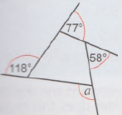
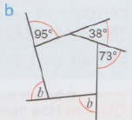
6.4 – Interior and Exterior Angles
Page 47
Work out the sizes of the missing exterior angles for each polygon.
R Anna says, ‘I can work out the size of the exterior angles of an irregular octagon by dividing 360° by 8.'
Is Anna correct? Explain.
a

Slide 104
6.4 – Interior and Exterior Angles
Page 47
R The diagram shows an exterior and an interior angle of a regular polygon.
Workout the number of sides of the polygon,
What do the interior and exterior angles add up to?
Copy and complete this rule.
The interior and exterior angles always sum to □°.
Explain why this rule is true.

Slide 105
6.4 – Interior and Exterior Angles
Page 47
Work out the sizes of the angles marked with letters.
Copy and complete this table.
Regular Polygon | Exterior Angle | Interior Angle
Triangle
Hexagon
Octagon

Slide 106
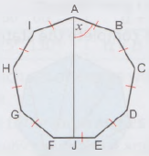
6.4 – Interior and Exterior Angles
Page 47
A regular polygon has an interior angle of 168°. Find the size of the exterior angle and work out how many sides the polygon has.
P Point J lies on the midpoint of EF. Find the size of angle x.

Slide 107
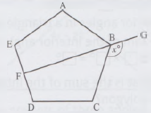
6.4 – Interior and Exterior Angles
Page 47
14 – Exam-Style Questions
ABCDE is a regular pentagon.
FBG is a line of symmetry.
Angle CBG = x°
Work out the value of x. (4 marks)

Slide 108
6.5 – More Interior and Exterior Angles
Page 48
Copy this hexagon onto triangular paper.
Continue your diagram to show how hexagons fit together.
Show that hexagons fit together by considering the interior angles.
Do regular heptagons fit together? Explain your answer by considering the interior angles.

Slide 109
6.5 – More Interior and Exterior Angles
Page 48
Copy this triangle onto squared paper.
Show how triangles fit together by drawing five more on your diagram.

Slide 110
6.5 – More Interior and Exterior Angles
Page 48
R Copy and complete the statements
below.
This shape has □ sides.
It is made of □ triangles.
The interior angles in a triangle add up to □°. So the sum of the interior angles in this shape is □ x □° = □°

Slide 111
6.5 – More Interior and Exterior Angles
Page 48
a R What is the sum of the interior angles of this polygon?
How many triangles can you divide an n-sided polygon into?
Write a formula to work out the sum of the interior angles, S, for a polygon with n sides.

Slide 112
6.5 – More Interior and Exterior Angles
Page 48
For each irregular polygon, work out
the sum of the interior angles
the size of the angle marked with a letter.

Slide 113
6.5 – More Interior and Exterior Angles
Page 48
For each shape, work out the size of
the angle sum
the interior angle.
regular octagon
regular nonagon
15-sided regular polygon
For each polygon, work out the number of sides from the sum of its interior angles,
900° b 1980°
2880° d 5220°

Slide 114
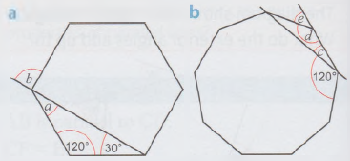
6.5 – More Interior and Exterior Angles
Page 48
The diagrams show regular polygons with some angles given.
Work out the sizes of the angles marked with letters. Give reasons for your answers. Choose reasons from the box.
The sum of the interior angles of a regular polygon = (n - 2) x 180°.
The triangle is isosceles.
Exterior and interior angles add up to 180°.
Q9b hint - How many sides does this regular polygon have?

Slide 115


6.5 – More Interior and Exterior Angles
Page 48
P ABCDEFGH is a regular octagon.
Find the size of angle CED.

Slide 116

6.5 – More Interior and Exterior Angles
Page 49
11 – Exam-Style Questions
AB, BC and CD are three sides of a regular 12-sided polygon.
EBD is a straight line.
Angle EBC = x°
Work out the value of x.
(4 marks)

Slide 117
6.6 – Geometrical Problems
Page 49
Work out the value of x in each diagram.
a
c

Slide 118
6.6 – Geometrical Problems
Page 49
R Look at
the diagram.
i Explain why
x + 50° = 2x + 30°
ii Work out the value of x.
iii Work out the sizes of the angles.
Work out
the sizes
of the
angles.

Slide 119
6.6 – Geometrical Problems
Page 49
P Work out the values of a and b.
a
b

Slide 120
6.6 – Geometrical Problems
Page 49
Look at the diagram.
Write an equation in terms of x.
Solve this equation for x.
Write down the sizes of the three angles of the triangle.

Slide 121
6.6 – Geometrical Problems
Page 49
Write an equation in terms of x and use it to find the three angles of the triangle.
R What type of triangle is this? Explain

Slide 122
6.6 – Geometrical Problems
Page 49
a The left-hand column of the table shows the angles in three different triangles.
The right-hand column shows equations that have been written about the triangles, but not in order.
Match each set of angles with the correct equation.
Here are three more angles: 40°, 50°, 80°. Explain why these three angles do not come from a triangle.
Angles | Equations
50°, 60°, 70° | 3a = 180°
20°, 70°, 90° | 2a + b = 180°
60°, 60°, 60° | a + b = 90°
25°, 25°, 130° | a + b + c = 180°

Slide 123
6.6 – Geometrical Problems
Page 49
In the box are sets of three angles, written as expressions in x.
For each set, which of these is true?
These three angles can always / sometimes / never make a triangle.
2x, 4x, 4x 3x, 2x, x
100° - x, x + 60°, 20°
x + 50°, x-50°, x + 120°
2x + 30°, 50°- x, 40°- x

Slide 124

6.6 – Geometrical Problems
Page 50
9 – Exam-Style Questions
All angles are measured in degrees.
AGB and CEFD are straight lines.
Angle GEF = 3a - 10
Angle BGF = a + 30 Angle EGF = y
Show that y = 160 - 4a
Give reasons for each stage of your working. (3 marks)
Given that a = 25,
work out the value of y
work out the size of the largest angle in triangle EGF. (4 marks)

Slide 125
6.6 – Geometrical Problems
Page 50
Exam hint
‘Show that’ means you need to write down all of your working and explain your reasons as you go along. You can answer part b even if you cannot answer part a.
P Triangle ACD is an isosceles triangle. Triangle BDE is a right-angled triangle. Show that triangle ABD is an equilateral triangle.

Slide 126

6.6 – Geometrical Problems
Page 50
P ABC is a triangle.
D is a point on AC.
Find the size of angle ACB.

Slide 127
6 – Problem Solving
Page 50
Solve problems using these strategies where appropriate:
Use pictures
Use smaller numbers
Use bar models
Use x for the unknown.
R I think of a 2D shape. It has only four sides. They are all straight.
What could my shape be? Write a list.
It has two different pairs of equal length sides,
What could my shape be now? Write a new list.

Slide 128
6 – Problem Solving
Page 50
R A regular polygon has an even number of sides and fewer than six sides.
What is the name of the shape?
What is the size of an interior angle of the polygon?
A quadrilateral has two pairs of equal angles. The angles next to each other are different.
What type of quadrilateral is this?
One of the angles is 65°. What are the other three angles?

Slide 129

6 – Problem Solving
Page 50
4 – Exam-Style Questions
Angle AFC = x° and Angle ACB = y°.
What is the value of x? (2 marks)
What is the value of y? (2 marks)
Give reasons for your answers.

Slide 130


6 – Problem Solving
Page 50
In the quadrilateral below, x is $\frac{2}{3}$ of ∠ABC and y is $\frac{5}{6}$ of ∠ABC.
What are the values of x, y and z?

Slide 131

6 – Problem Solving
Page 51
AG is parallel to HD.
AB = AF and CBG = 66°.
What is the size of angle HEF?
Are FD and FE the same length?
How can you tell?

Slide 132

6 – Problem Solving
Page 51
Angle ACB is
double the size
of angle BAC.
Write an equation for the sum of the angles in triangle ABC.
What is the size of ∠ABC?
What is the size of ∠CEF?
Give reasons for your answers.
Q7 hint - Use x for the unknown.

Slide 133

6 – Problem Solving
Page 51
R Karl says, 'Angles a, b and c must add up
to 180° in
the polygon
PQRST.‘
Is he right? How can you tell?
Use the diagram to show that the sum of the interior angles in a pentagon add up to 540°.

Slide 134
6 – Problem Solving
Page 51
The diagram below shows part of a regular polygon and an extended line.
The exterior angle is one-fifth of the size of the interior angle.
What is the size of the exterior angle of the polygon?
How many sides does the polygon have?

Slide 135
6 – Problem Solving
Page 51
10 – Exam-Style Questions
The diagram shows two congruent regular heptagons on a straight line. Angle CAB = x°.
Show that triangle ABC is not an equilateral triangle. (3 marks)
What is the size of x to 1 d.p.?
(2 marks)

Slide 136

6 – Problem Solving
Page 51
Two regular polygons share a common side BE. EBX is a straight line.
Angle ABC = angle DEF = 90°.
Angle CBX is half of angle ABX.
What is the size of angle ABE?
Name the polygons.

Slide 137
7.1 – Averages & Ranges – Mean & Range
Page 52
Here are the ages, in
years, of the first 10
customers in a shop.
44, 65, 73, 12, 38,3,
67, 81, 19, 28 Work
out the mean age of
the customers.
The table shows the rainfall for the first four months of one year. Work out the mean rainfall per month.
Month | January | February | March | April
Rainfall (mm) | 160 | 97 | 108 | 145

Slide 138
7.1 – Averages & Ranges – Mean & Range
Page 52
3 – Exam-Style Questions
The table shows the scores for 10 students in a maths exam.
Find the range of scores.
Write down the mode.
Work out the mean score. (5 marks)
Student | A | B | C | D | E | F | G | H | I | J
Score | 23 | 15 | 20 | 19 | 18 | 19 | 20 | 17 | 16 | 20
Mr. Adiga records how late his train is each morning, in minutes.
3, 5, 6, 5, 3, 2,1, 0, 0,1,1, 0,1, 2,1, 12, 1, 4, 4, 5
Work out the mean time the train is late,
Work out the range.

Slide 139
7.1 – Averages & Ranges – Mean & Range
Page 52
Here are the numbers of films that customers using a broadband service buy in a month.
3, 0, 1,1, 2,1, 0, 1, 0, 1, 1, 1, 2, 2, 2, 3, 2, 2, 2, 3 The numbers are shown again in the table.
Copy and complete the table,
Find the total number of films downloaded
Find the total number of customers asked,
Use your answers to parts b and c to work out the mean number of films downloaded.
Number of films downloaded, n | Frequency, f | n x f
0 | 3 | 0 x 3 = 0
1
2
3

Slide 140
7.1 – Averages & Ranges – Mean & Range
Page 52
The weights of 100 newborn babies were recorded, to the nearest kg.
The results are shown in the table.
Work out the mean,
Work out the range. Give your answers to an appropriate degree of accuracy.
Weight, w (kg) | Frequency, f | w x f
1 | 3
2 | 19
3 | 47
4 | 30
5 | 1

Slide 141

7.1 – Averages & Ranges – Mean & Range
Page 52
R The charts show the times, to the nearest 5 minutes, spent by students in class a11A and class 11B on their maths homework.
Copy and complete the frequency table for class 11 A.
Time, t (min) | Frequency, f | t x f
5 | 1
10 | 0
15 | 5
20
25
30
35
40

Slide 142
7.1 – Averages & Ranges – Mean & Range
Page 53
Work out the mean and range for class 11A.
Give your answer correct to 1 decimal place.
Make a frequency table for class 11B.
Work out the mean and range for class 11B.
Choose words from the box to fill the gaps.
Class ______ works harder than class _______ because their mean is _______ and their range is ________. A smaller range shows the data is ________ spread out.
higher more smaller 11A less 11B

Slide 143
7.1 – Averages & Ranges – Mean & Range
Page 53
R Two football teams recorded how many goals they scored in 10 matches.
Team A: 3, 4, 4, 3, 2, 5, 2, 4, 2, 1
Team B: 0, 1, 7, 1, 0, 5, 1, 8, 6, 1
Find the mean score for each team,
Find the range for each team.
Which team is more consistent?
Which team would you support? Give a reason.

Slide 144

7.1 – Averages & Ranges – Mean & Range
Page 53
9 – Exam-Style Questions
Adele rolls a dice 5 times.
Her first 4 scores are 3, 5, 2 and 6.
The mean of her 5 scores is 4. What does she get on her final roll? (3 marks)
Q9 hint - Work out what the total of the 5 rolls of the dice must be.

Slide 145
7.1 – Averages & Ranges – Mean & Range
Page 53
10 – Exam-Style Questions
The table shows the numbers of computers owned by 30 families who live on the same road.
Work out the mean number of computers per family. Give your answer correct to 1 decimal place. (3 marks)
Number of Computers | Frequency
0 | 1
1 | 7
2 | 12
3 | 5
4 | 3
5 | 2

Slide 146
7.2 – Mode, Median and Range
Page 53
The stem and leaf diagram shows the prices, to the nearest £1000, of cars in a showroom.
0 │ 9 9
1 │ 1 2 2 3 5 7 8
2 │ 9 9
3 │ 2 5
4 │ 1
Key
0 │ 9 means £9000
How many cars are there?
Work out the range of the prices.

Slide 147
7.2 – Mode, Median and Range
Page 53
R Why is the mode not a
useful average for the
data in Q1?
This stem and leaf diagram
shows the weights of cats taken to a vet clinic.
1 │ 3 7 8 9
2 │ 0 0 3 5 8 9
3 │ 0 2 4
4 │ 1 3 5
5 │ 2
Key
2 │ 0 means 2.0 kg.
Find
the mode b the median
the range.

Slide 148
7.2 – Mode, Median and Range
Page 53
4 – Exam-Style Questions
Aatami recorded the lengths, in millimetres, of a sample of leaves.
He drew this stem and leaf diagram for
his results.
3 │ 1 3 5 7
4 │ 2 2 2 6 7 9
5 │ 3 3 9
6 │ 0 1
Key
3 │ 1 represents 31 mm.
Write down the number of leaves in the sample. (1 mark)
Write down the mode. (1 mark)
Work out the range. (2 marks)

Slide 149

7.2 – Mode, Median and Range
Page 54
A maths teacher records students' marks in the end-of-year test.
5 │ 6 6 7 7 8 9 9
6 │ 0 1 4 5 5 7 7 8 9
7 │ 2 4 5 5 6 7
8 │ 5 6 9 9 9
9 │ 8
Key
5 │ 6 represents 56%.
Find
the mode b the median
the range.
Q5b hint - There are 28 values. The position of the median is $\frac{28 + 1}{2}$ = 14.5, so the median is halfway between the 14th and 15th values.

Slide 150
7.2 – Mode, Median and Range
Page 54
R For each set of experimental data below
identify the outlier
work out the range
work out the range ignoring the outlier,
24°, 18°, 19°, 22°, 12°, 19°, 25°, 17°
3.7 mm, 3.9 mm, 2.9 mm, 4.8 mm, 5.2 mm, 0.4 mm, 5.6 mm, 3.9 mm
1.02 kg, 0.75 kg, 1.09 kg, 0.98 kg, 0.95 kg, 1.03 kg, 1.05 kg
Marta recorded these sets of experimental data. The outliers are likely to be errors. Work out the range of each data set, ignoring any outliers.
17,19,18,13,4,15
9.2, 8.9, 9.4, 3.5, 8.1, 8.9, 9.5

Slide 151

7.2 – Mode, Median and Range
Page 54
Jayne measured the lengths and masses of a sample of metal rods. The diagram shows the results.
Find the range of the masses, ignoring any outliers.

Slide 152
7.2 – Mode, Median and Range
Page 54
In a traffic survey, the number of cars passing each minute was recorded.
Estimate the range of the number of cars.
Number of Cars | Frequency
0 – 10 | 1
11 – 20 | 2
21 – 30 | 17
31 – 40 | 8
41 – 50 | 3

Slide 153
7.2 – Mode, Median and Range
Page 54
A factory records the weight, in grams, of bags of flour.
The table shows the results.
Write down the largest possible weight that one of these bags of flour could have.
Write down the smallest possible weight that one of these bags of flour could have,
Estimate the range.
Number of Cars | Frequency
960 < w ≤ 970 | 14
970 < w ≤ 980 | 56
980 < w ≤ 990 | 125
990 < w ≤ 1000 | 391
1000 < w ≤ 1010 | 25

Slide 154
7.2 – Mode, Median and Range
Page 54
The instructor records the weight (in kg) of participants at a fitness class.
Estimate the range of the weights.
Weight, w (kg) | Frequency
60 ≤ w < 65 | 14
65 ≤ w < 70 | 12
70 ≤ w < 80 | 18
80 ≤ w < 90 | 3

Slide 155
7.3 – Types of Average
Page 54
Find the mode of each data set.
54, 59, 55, 56, 52, 56, 51, 56, 59
0.5, 0.9, 0.5, 1.1, 1.3, 1.4, 1.6, 1.2
Is the mode a good representative value for both data sets?
Find the mean of each data set.
105,109,110,82,111
3, 4, 4, 2, 4
Is the mean a good representative value for both data sets?

Slide 156
7.3 – Types of Average
Page 54
Find the median of each data set.
0.2,1.1,1.5,1.6,0.3,0.3,02
101,104, 99,105, 107, 234, 105
Is the median a good representative value for both data sets?
R Work out the most appropriate average for each data set.
6, 7, 5, 6, 9, 2, 6, 54
3.2, 5.4, 3.2, 3.2, 10.8, 4.5, 4.9
TV, TV, DVD, film, TV, DVD
83, 79, 81, 83, 82

Slide 157

7.3 – Types of Average
Page 55
a Find the median of 1.2, 3.4, 5.6, 7.6, 8.5
Find the median of 1.2, 3.4, 5.6, 7.6, 18.5
Find the median of 1.2, 3.4, 5.6, 7.6, 28.5
Decide if each statement is true or false,
The median will always change if one data value changes.
With numerical data, there will always be a mean.
The mean will be affected by extreme values.
The mode will always be affected by extreme values.
The mode is the only average that can be used with non-numerical data.

Slide 158
7.3 – Types of Average
Page 55
The table shows the numbers of library books borrowed by customers one day.
What is the modal class?
Number of Books | Frequency
1 – 2 | 15
3 – 4 | 12
5 – 6 | 5
7 – 8 | 2

Slide 159
7.3 – Types of Average
Page 55
This table shows the times taken some students to run 1500 metres.
Write down the modal class.
Time, t (min) | Frequency
7 < t ≤ 8 | 13
8 < t ≤ 9 | 19
9 < t ≤ 10 | 4
10 < t ≤ 11 | 1

Slide 160
7.3 – Types of Average
Page 55
Andrew rolled a dice 50 times. The table shows his results.
Find the median score.
Score | Frequency
1 | 7
2 | 9
3 | 11
4 | 6
5 | 8
6 | 9

Slide 161
7.3 – Types of Average
Page 55
Megan recorded the number of lengths she swam each week for 6 months.
Find the median number of lengths she swam.
What is the mode?
Work out the mean number of lengths she swam (to 1 d. p.).
Number of Lengths | Frequency
50 | 12
51 | 5
52 | 2
53 | 7

Slide 162
7.3 – Types of Average
Page 55
The number of cars using a bridge during rush hour is recorded over a month.
Which class contains the median?
Number of Cars | Frequency
250 – 300 | 7
301 – 350 | 12
351 – 400 | 9
401 – 450 | 3

Slide 163
7.3 – Types of Average
Page 55
12 – Exam-Style Questions
This table gives information about the amount of extra time, in minutes, awarded by a football referee.
Write down the modal class interval. (1 mark)
Find the class interval that contains the median. (2 marks)
How many matches had 4 or more minutes of extra time? (2 marks)
Extra time, t (min) | Frequency
0 ≤ w < 2 | 4
2 ≤ w < 4 | 11
4 ≤ w < 6 | 3
6 ≤ w < 8 | 1
Q12 hint - Write the class as: □ ≤ t < □

Slide 164
7.4 – Estimating the Mean
Page 56
Write each of these in hours and minutes to the nearest minute,
4.21 hours b 1.072 hours
5.391 hours
This table gives information about the time, in minutes, a doctor spends with her patients.
Work out an estimate of the mean time the doctor spends with each patient.
Give your answer to the nearest minute.
Time, t (min) | Frequency
1 – 10 | 8
11 – 20 | 23
21 – 30 | 14
31 – 40 | 5

Slide 165

7.4 – Estimating the Mean
Page 56
In a survey, 20 people were asked the distance, in miles, they travel to work. This table shows the results.
Calculate an estimate for the mean distance travelled.
Distance, d (miles) | Frequency | Midpoint of class, m | m x f
1 – 9 | 9
10 – 18 | 3
19 – 27 | 7
28 – 36 | 1
Total |  | Total
Q2 hint - To find the midpoint of a class add together the endpoints and divide by 2.
The midpoint of the class 1-9 is $\frac{1+9}{2}$= 5

Slide 166
7.4 – Estimating the Mean
Page 56
The table shows how long, in seconds, some children could hop for.
Work out an estimate of the mean time. Give your answer to the nearest second.
Time, t (seconds) | Frequency
30 < t ≤ 60 | 2
60 < t ≤ 90 | 11
90 < t ≤ 120 | 19
120 < t ≤ 150 | 3

Slide 167
7.4 – Estimating the Mean
Page 56
The rainfall (in cm) for a town in the UK is recorded each day during April.
0.3, 0.9, 0, 0, 0.4, 0, 0, 0.5, 0.1, 0.1, 0.2, 0.2, 0.7, 0.2, 0.1, 0.5, 0.3, 0.2, 1.1, 0.8, 0.8, 0.6, 0.3, 0, 0, 0.3, 0.4, 0.7, 0.9, 1.1
Copy and complete the frequency table
Work out an estimate of the mean rainfall,
What is the modal class?
Which class contains the median?
Estimate the range of the rainfall.
Rainfall, r (cm) | Frequency, f
0 ≤ r < 0.3
0.3 ≤ r < 0.6
0.6 ≤ r < 0.9
0.9 ≤ r < 1.2

Slide 168
7.4 – Estimating the Mean
Page 56
6 – Exam-Style Questions
This table gives information about the heights, in metres, of a class of students.
Work out an estimate of the mean height of the students. Give your answer to an appropriate level of accuracy. (5 marks)
Explain why your answer is only an estimate. (1 mark)
Height, h (m) | Frequency, f
1.2 ≤ r < 1.4 | 2
1.4 ≤ r < 1.6 | 13
1.6 ≤ r < 1.8 | 9
1.8 ≤ r < 2 | 1

Slide 169
7.5 – Sampling
Page 56
R A chocolate bar manufacturer wants to know how many people in the UK buy their brand.
What is meant by the population in this case?
Explain why a sample is needed,
The UK population is approximately 64 million. How many people should they choose for the sample?
100 1000 10000 100000 1000000
Saira wants to find out what percentage of the population in her town walk to their workplace. She carries out a survey at her school.
What is meant by the population in this case?
Comment on the sample Saira is using.

Slide 170
7.5 – Sampling
Page 56
Mahnoor wants to find out how much time people spend watching TV each day.
He asks his friends at his cricket club,
Explain why Mahnoor's sample is not reliable,
How could Mahnoor improve his survey?
R Michel and Brian are carrying out a survey to find out how long people spend on their Christmas shopping.
Michel chooses a sample at a shopping centre.
Brian chooses a sample at the local gym.
Would you expect them to get similar results?

Slide 171
7.5 – Sampling
Page 57
The manager of a swimming pool wants to find out what customers think of the facilities. She decides to ask everyone who comes on a Saturday morning.
Will this give fair or biased results?
How can she improve her survey?

Slide 172
7.5 – Sampling
Page 57
The owner and the manager of a beauty salon are both selecting a sample of 10 customers.
The manager selects her sample by picking the first 10 customers who have an appointment that day.
Will this give a random sample?
Explain your answer.
The owner selects her sample by giving each customer a number and then using a computer program to randomly generate a number to pick.
Will this give a random sample?
Explain your answer.

Slide 173
7.5 – Sampling
Page 57
a Here is a list of random numbers. 234, 892, 481, 363, 945, 651, 699, 152, 301, 392
Write down two digits from each number.
Explain how you could use the two digits to pick 10 people at random from a numbered list.
Mrs. Avery has a list of 100 students.
She wants to pick 10 students at random to ask about school lunches. Explain how she could use the random numbers from part a to pick students from the list.
Q7a hint – 2 3 4 8 9 2

Slide 174
7.5 – Sampling
Page 57
8 – Exam-Style Questions
A gym wishes to improve its customer service.
It has 250 registered users. The manager wants to carry out a survey using a random sample.
Describe two ways she could select a random sample. (2 marks)

Slide 175
7.5 – Sampling
Page 57
R An online survey is used to predict people's spending on foreign holidays next year.
The company surveyed 6400 people. They picked 4000 from those registered online with an email address and picked the remaining 2400 from theFrom the 6400 people who responded, the average spend on a foreign holiday the following year was predicted to be £850 per person.
The actual spend per person that year was approximately £950 per person,
Was the survey accurate?
Explain why the sample might be biased. electoral role.

Slide 176

7 – Problem Solving
Page 57
Solve problems using these strategies where appropriate:
Use pictures
Use smaller numbers
Use bar models
Use x for the unknown.
1 – Exam-Style Questions
The pictogram shows the number of calculators sold by the maths department each month for five months.
Work out how many calculators were sold in October. (1 mark)
Use the information in parts b and c to help fill in the pictogram.
The sales in January were the same as in November. (1 mark)
The range for the sales is 16 calculators. The sales figure in December was the lowest. (1 mark)
What is the mode? (1 mark)

Slide 177
7.5 – Sampling
Page 57
R Here is a list of numbers.
13,17,12,19
What is the range of the numbers?
A number is added to the list.
The new range is 9.
What number was added to the list?
Show that there are two possible solutions to this problem.
R Four children stand in a row. The height of the shortest child is 1.2 m and the height of the tallest child is 1.5 m.
Which of the following could be the mean height of the children? Why?
A 0.3 m B 1.2 m C1.3m D 1.5m
E 2.7m
Assuming your answer to part a is correct, what could be the heights of the other two children?

Slide 178

7.5 – Sampling
Page 58
The total weight of 5 pellets is 360g. One pellet is removed and the mean weight of the remaining pellets is 75g.
What is the weight of the pellet that was removed?
Was the weight of the pellet that was removed below or above the mean weight? Show how you know.
Dan wants to buy a new pair of skis.
Shop A charges £480 but gives 15% discount for club members.
Shop B charges £660, and is having a sale giving $\frac{1}{3}y$ off.
If Dan pays £25 to join the club, which shop offers the better deal?

Slide 179
7.5 – Sampling
Page 58
Dean is comparing the data on the numbers of siblings (brothers and
sisters) that students in two classes have.
Both classes have 25 students. The tables show his results.
Dean says, 'I can see from the tables
that the average number of siblings in class A is 1 while in class B the average number of siblings is 2.'
Is he correct? Explain.
Dean also says, Therefore the mean for class B is higher than that of class A.'
Is he correct? Explain,
What is the mean number of siblings in each class?
What is the median number of siblings in each class?
Write two statements to compare the data.
No of Siblings in Class A | Frequency |  | No of Siblings in Class B | Frequency
0 | 1 |  | 0 | 0
1 | 9 |  | 1 | 8
2 | 8 |  | 2 | 14
3 | 4 |  | 3 | 2
4 | 3 |  | 4 | 0
 |  |  | 5 | 1
Q6a hint - Sketching a dual bar chart may help.

Slide 180
7.5 – Sampling
Page 58
7 – Exam-Style Questions
These are the scores that Lizzie got in her last 9 practice papers.
36, 44, 58, 66, 34, 70, 78, 64, 80
What is her score on her 10th paper if:
the range of her 10 scores is 51 (1 mark)
the median of her 10 scores is 62 (2 marks)
the mean of her 10 scores is 62? (2 marks)

Slide 181
7.5 – Sampling
Page 58
R Here is a set of data arranged in ascending order: x, x + 1, x + 1, 3x - 7, 4x + 5
Work out the range, mode, median and mean for the set of data.
Another number, bigger than 4x + 5, is included in the data,
What is the new median?

Slide 182
7.5 – Sampling
Page 58
R The table shows the numbers of letters received by post in a week by the families in one street.
Calculate an estimate for the mean number of letters that is received per family on the street.
One family was not recorded in the table. When they are included in the data, the new estimate for the mean is 9.9. How many letters did this family receive in that week?
How will this entry change the table above?
Number of letters, x | Number of families
0 ≤ r < 4 | 6
4 ≤ r < 8 | 10
8 ≤ r < 12 | 10
12 ≤ r < 16 | 9
16 ≤ r < 20 | 5

Slide 183
7.5 – Sampling
Page 58
R The missing frequencies for the table below are 1, 4, 6, 8 and 12, but not necessarily in that order.
Copy the table three times and complete the tables so that
15 < x =£ 20 is the mode
25 < x 30 is the median
you get the highest possible estimate of the mean. Show that the estimated mean will be 26.7 years (1 d.p.).
Age (years) | Frequency
10 < r ≤ 15
15 < r ≤ 20
20 < r ≤ 25
25 < r ≤ 30
30 < r ≤ 35

Slide 184
8.1 – Rectangles, Parallelograms and Triangles
Page 59
Calculate the area of each parallelogram.
Calculate the perimeter and area of each shape. All lengths are in centimetres.
a
c
a

Slide 185

8.1 – Rectangles, Parallelograms and Triangles
Page 59
R a Work out
the area of
this
parallelogram.
Trace the parallelogram. Join opposite vertices with a straight line to make two triangles.
What fraction of the parallelogram is each triangle?
Write down the area of one of the triangles.

Slide 186

8.1 – Rectangles, Parallelograms and Triangles
Page 59
a
Calculate the area of each triangle.
c
Q4 hint - Find the base first. The height is perpendicular to the base.

Slide 187

8.1 – Rectangles, Parallelograms and Triangles
Page 59
Calculate the perimeter and area of each shape.
All lengths are in centimetres.
A triangle has base length 5.6 cm and height 9 cm.
Calculate its area.

Slide 188

8.1 – Rectangles, Parallelograms and Triangles
Page 59
P Sam makes place mats from triangles cut from a wooden board.
Each place mat has a border of veneer around the whole triangle.
He makes 15 of these triangles.
Work out
the area of wood he needs
the length of veneer he needs.

Slide 189
8.1 – Rectangles, Parallelograms and Triangles
Page 60
P Sketch and label three triangles that have area 12cm².
9 – Exam-Style Questions
These shapes are drawn on centimetre squared paper.
Calculate the area of each one.
(6 marks)

Slide 190

8.1 – Rectangles, Parallelograms and Triangles
Page 60
P Each shape has an area of 30cm². Calculate the lengths marked by letters.

Slide 191
8.1 – Rectangles, Parallelograms and Triangles
Page 60
A rectangular room measures 4.5 m by 5.1 m, and is 2.4 m high.
Sketch four rectangles to represent the four walls. Label their lengths and widths.
Calculate the total area of the walls.
A tin of paint costs £8.99 and covers 5 m². Estimate the cost of the paint for the walls.

Slide 192

8.2 – Trapezia and Changing Units
Page 60
Calculate the areas of these trapezia.
All lengths are in centimetres. Round answers to 1 decimal place where necessary.

Slide 193

8.2 – Trapezia and Changing Units
Page 60
Calculate the area and perimeter of this isosceles trapezium.
Q2 hint - An isosceles trapezium has one line of symmetry. Its two sloping sides are equal.

Slide 194

8.2 – Trapezia and Changing Units
Page 60
P This trapezium has area 36cm².
Substitute the values for A, a and b into the formula A = ½ (a + b)h
Simplify your answer to part a.
Solve your equation from part b to find h. Give the units with your answer.

Slide 195

8.2 – Trapezia and Changing Units
Page 60
P This trapezium has area 21 m².
Work out its height.
Convert
1850 mm² to cm²
29.2 cm² to mm²

Slide 196
8.2 – Trapezia and Changing Units
Page 60
a Calculate the area of this square in cm².
Convert your answer to mm².
3.2 cm

Slide 197

8.2 – Trapezia and Changing Units
Page 60
R a Use these diagrams to help you work out the number of cm² in 4 m².
Copy and complete the double number line.
2 m
200
cm
2 m
200 cm

Slide 198
8.2 – Trapezia and Changing Units
Page 61
Convert
5.8 m² to cm²
12 500 cm² to m²
a Choose four decimal measures between 3 m² and 4 m².
Convert each measure to cm².
Choose four measures between 18000 cm² and 20000 cm².
Convert each measure to m².

Slide 199
8.2 – Trapezia and Changing Units
Page 61
The diagram shows a paving stone.
Work out the area of the stone in m².
Convert your answer to part a to cm².
Convert the length and the width of the paving stone to cm.
Use these
measurements
to work out the
area of the
paving stone
in cm².
1.6 m
1.2 m

Slide 200

8.2 – Trapezia and Changing Units
Page 61
P Work out these areas in cm².
a
c

Slide 201
8.2 – Trapezia and Changing Units
Page 61
12 – Exam-Style Questions
Work out the area of this rectangle
in cm²
in mm²
(3 marks)
0.6 cm
1.4 cm
P Aisha is doing a wildlife survey, In Field A she finds 40 species in an area of 1.4 m².
In Field B she finds 25 species in an area of 3000 cm².
Which field has more species per square metre? Show working to explain.

Slide 202


8.3 – Trapezia and Changing Units
Page 61
Convert these areas to the units given,
5 ha to m² b 7.5 ha to m²
80 000 m² to ha
125 000 m² to ha
a Use these diagrams to help you work out the number of m² in 4 km².
Copy and complete the double number line.

Slide 203
8.3 – Trapezia and Changing Units
Page 61
R Iona and Oronsay are islands of the Inner Hebrides.
The area of Iona is 8.77 km².
The area of Oronsay is 519 ha.
Which is larger, Iona or Oronsay?
What is the difference in area?

Slide 204

8.3 – Trapezia and Changing Units
Page 61
The diagram shows a shape split into two rectangles, A and B.?
Work out
the areas of A and B
the total area
the total perimeter.

Slide 205



8.3 – Trapezia and Changing Units
Page 61
Calculate the area and perimeter of these compound shapes.
a
c

Slide 206



8.3 – Trapezia and Changing Units
Page 62
Here is a compound shape. There are two ways of working out its area.
Method 2
Work out the areas of B, C and D and add them together.
Method 1
Work out the area of the whole rectangle and subtract area A.
Work out the area using both methods,
Which do you prefer? Explain why.

Slide 207

8.3 – Trapezia and Changing Units
Page 62
Calculate the area and perimeter of each shape.

Slide 208



8.3 – Trapezia and Changing Units
Page 62
Work out the area of each shape.

Slide 209

8.3 – Trapezia and Changing Units
Page 62
a Sketch this isosceles trapezium.
Divide it into two triangles and a rectangle,
Work out the area of each part, then add to find the total area.
How could you work out the area of a trapezium if you forget the area formula?

Slide 210

8.3 – Trapezia and Changing Units
Page 62
P Rose makes this photo frame by cutting a rectangle 20 cm by 15 cm out of a larger rectangle of card.
Work out the area of card in the frame.
Q10 hint - Work out the area of the larger rectangle then subtract the area of the cut out rectangle.

Slide 211

8.3 – Trapezia and Changing Units
Page 62
11 – Exam-Style Questions
This window consists of a wooden frame with two panes of glass.
Work out the area of wood used.
(3 marks)
140 cm

Slide 212

8.4 – Surface Area of 3D Solids
Page 62
Work out the surface area of this cuboid.

Slide 213

8.4 – Surface Area of 3D Solids
Page 63
R a Look at this diagram of a cuboid.
What is the area of the top of the cuboid?
Which other face of the cuboid is identical to this one?
i What is the area of the front of this cuboid?
ii Which other face of the cuboid is identical to this one?
i What is the area of the side of this cuboid?
  ii Which other face of the cuboid is identical to this one?
Copy and complete this calculation to work out the total surface area of the cuboid.
2 x □ + 2 x □ + 2 x □ = □ cm²

Slide 214

8.4 – Surface Area of 3D Solids
Page 63
Calculate the surface area of each cuboid.
a
c

Slide 215
8.4 – Surface Area of 3D Solids
Page 63
a Sketch a net of this triangular prism. Label the lengths.
Work out
the area of each face
the total surface area.

Slide 216

8.4 – Surface Area of 3D Solids
Page 63
Calculate the surface area of each 3D solid.

Slide 217
8.4 – Surface Area of 3D Solids
Page 63
P The stand for a model is in the shape of a cuboid.
It is 65mm long, 52mm wide and 25mm tall. Ellie varnishes all the faces except the bottom.
Work out the total area she varnishes, in square centimetres,
One tin of varnish covers 120 cm².
How many tins of varnish does Ellie need to varnish 5 model stands?

Slide 218

8.4 – Surface Area of 3D Solids
Page 63
These stools are covered with fabric.
Work out how many square metres of fabric you will need to cover them both. The fabric costs £7.49 per square metre,
Estimate the cost of the fabric needed to cover them both.

Slide 219

8.4 – Surface Area of 3D Solids
Page 63
P/R This cube has surface area 726 cm². What is the length of one side of the cube?
Q8 hint - First work out the area of one face.
9 – Exam-Style Questions
Storage boxes are 60 cm wooden cubes, painted on all faces.
Work out the area to be painted on one box.
One tin of paint covers an area of 25 m2. How many whole boxes can be painted with one tin of paint? (4 marks)

Slide 220


8.5 - Volume of Prisms
Page 64
This cuboid is made of centimetre cubes.
Each cube has volume 1 cm³.
Work out the volume of the cuboid.
Here are some more cuboids made of 1 cm³ cubes.
Work out their volumes.

Slide 221

8.5 - Volume of Prisms
Page 64
Work out the volume of each cuboid. Give the correct units with your answer.

Slide 222
8.5 - Volume of Prisms
Page 64
This prism is made from centimetre cubes. Work out the volume of the prism.

Slide 223


8.5 - Volume of Prisms
Page 64
Calculate the volume of each prism.
C

Slide 224
8.5 - Volume of Prisms
Page 64
P/R The cross-section of a prism is a pentagon with area 8.4 cm².
The prism is 5.3 cm long.
Work out the volume of the prism.

Slide 225

8.5 - Volume of Prisms
Page 64
7 – Exam-Style Questions
The diagram shows a water
tank in the shape of a cuboid.
The tank is 1.8 m tall, 80 cm
long and 60 cm wide. The
depth of water in the tank is
1.4 m.
How many cubic metres
of water are in the tank? Give your answer to 2 decimal places. (3 marks)
Water costs £5.59 per cubic metre.
How much will it cost to fill the rest of the tank? (3 marks)
Q7 hint - Mark the depth of the water on the diagram. Before you start your working out, check what units you need to use for your answer. Do you need to change any units before you do the calculation?

Slide 226
8.5 - Volume of Prisms
Page 64
P A cube has volume 729 cm³.
How long is one side of the cube?
P Sketch and label the dimensions of three cuboids with volume 36 cm³.

Slide 227


8.6 – More Volume & Surface Area
Page 64
Convert
17 cm³ to mm³ b 25000 mm3 to cm³
6.1 cm³ to mm³ d 12870 mm³ to cm³
a Work out the
volume of this cuboid in cm³,
then convert it
to mm³.
Convert the measurements of the cuboid to mm, then work out the volume in mm³.
Q1 hint –

Slide 228
8.6 – More Volume & Surface Area
Page 65
Convert:
7.2 m³ into cm³
1.65 m³ into cm³
2 500 000 cm³ into m³
785 000 cm³ into m³
Convert:
0,8 litres into cm³
6600 cm³ into litres
12 m³ into cm³
4 m³ into litres
1.9 m³ into litres
8000 litres into m³
5.3 litres into cm³
Copy and complete:
1 m³ = □ litres

Slide 229


8.6 – More Volume & Surface Area
Page 65
This measuring cylinder can hold 100 ml.
What is the capacity of this measuring cylinder in cm³
A raised bed for growing
vegetables is in the shape
of a cuboid.
Phoebe wants to fill it with compost.
How many litres of compost does she need?

Slide 230

8.6 – More Volume & Surface Area
Page 65
Work out the capacity of this carton:
In ml b. In litres

Slide 231

8.6 – More Volume & Surface Area
Page 65
P Here is the design for a garden pond.
How much water will the pond contain? Give your answer in litres.
The bottom and sides of the pond are covered with a plastic lining.
How many square metres of lining are needed?

Slide 232


8.6 – More Volume & Surface Area
Page 65
Alex pours melted wax into moulds like this:
What volume of wax does he need for each candle:
Alex melts this cube of wax.
How many candles can he make with this wax?

Slide 233


8.6 – More Volume & Surface Area
Page 65
Work out the missing measurements in these cuboids.

Slide 234

8.6 – More Volume & Surface Area
Page 65
11 – Exam-Style Questions
This cuboid has volume 480 cm³.
Work out its surface area. (4 marks)

Slide 235

8 – Problem Solving
Page 66
Solve problems using these strategies where appropriate:
Use pictures
Use smaller numbers
Use bar models
Use x for the unknown
Use a flow diagram.
R A square is cut in half to form two identical rectangles. The rectangles have one side that is 6 cm long.
What could the length of the other side be? (There is more than one possible answer.)
What could the area of the square be?

Slide 236
8 – Problem Solving
Page 66
Nicola buys a new pair of running shoes and a T-shirt. She spent £86 on the shoes. This is £23 more than three times the cost of the T-shirt.
How much did the T-shirt cost?
R This trapezium is made up of a square and a triangle of the same area.
What is the height of the trapezium if its area is 242 cm²?

Slide 237
8 – Problem Solving
Page 66
A small field has a width that is 4.2 m shorter than its length. The perimeter is 75.6 m. What are the dimensions of the field?
R Casey has 60 jewellery boxes of dimensions 6 cm by 4.5 cm by 2 cm. She packs all of them neatly into a crate. There is no space left in the crate.
What is the capacity of the crate?
Suggest the dimensions of a suitable crate.

Slide 238
8 – Problem Solving
Page 66
5 – Exam-Style Questions
Jenny is redecorating her bathroom, which is 2.8 m wide by 3.5 m long and 3 m high.
She tiles one of the smaller walls and paints the other 3 walls.
The tiles are 35cm by 70cm and are sold in boxes of 10.
Each box costs £15.
Paint is sold in tins which cost £8.99 and cover 4.5 square metres.
Which will cost her more, the tiles or the paint?
How much more? (6 marks)

Slide 239

8 – Problem Solving
Page 66
In the shape below all lengths are in cm.
Write the down the perimeter of this shape in terms of x and y.
Show that x = 9
If x = 2y, what is the area of the shape?

Slide 240

8 – Problem Solving
Page 66
At an athletics event, $\frac{3}{5}$ of the crowd are adults. 75% of the remaining crowd are girls. There are 4500 girls in the crowd.
How many people in total are in the crowd at the athletics event?
Q7 hint - Draw a bar to represent all the crowd. Split the bar into 10 equal sections and work out what 1 section represents.

Slide 241

8 – Problem Solving
Page 66
R A butter manufacturer wants to sell butter in 48 cm³ portions. A manager chooses to package it in 2cm by 4cm by 6cm slabs. Suggest different dimensions so that less material is needed to wrap each slab of butter.
R A cylindrical tank of height 0.8 m and cross-sectional area 0.12 m² is $\frac{3}{4}$ full of oil.
Is there enough oil in the tank to fill 85 half-litre bottles of oil?
How can you tell?

Slide 242
8 – Problem Solving
Page 66
The cross-sectional area of shape A is 28 cm². It has a volume that is 1½ times that of shape B. What is the length x of shape A?

